Slide 1
Rene Magritte
Watercolor lesson on Positive and Negative Space

Slide 2
What is Positive and Negative Space? Simply put, positive space is best described as the areas in a work of art that are the subjects, or areas of interest. Negative space is area around the subjects, or areas of interest. The balance of positive and negative space is an important part of composition and the overall look of a work of art.

Slide 3
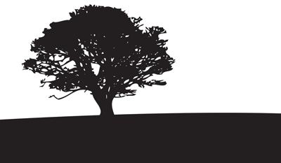
Which of these has equal parts positive and negative space? Which has more negative space? Positive space?

Slide 4
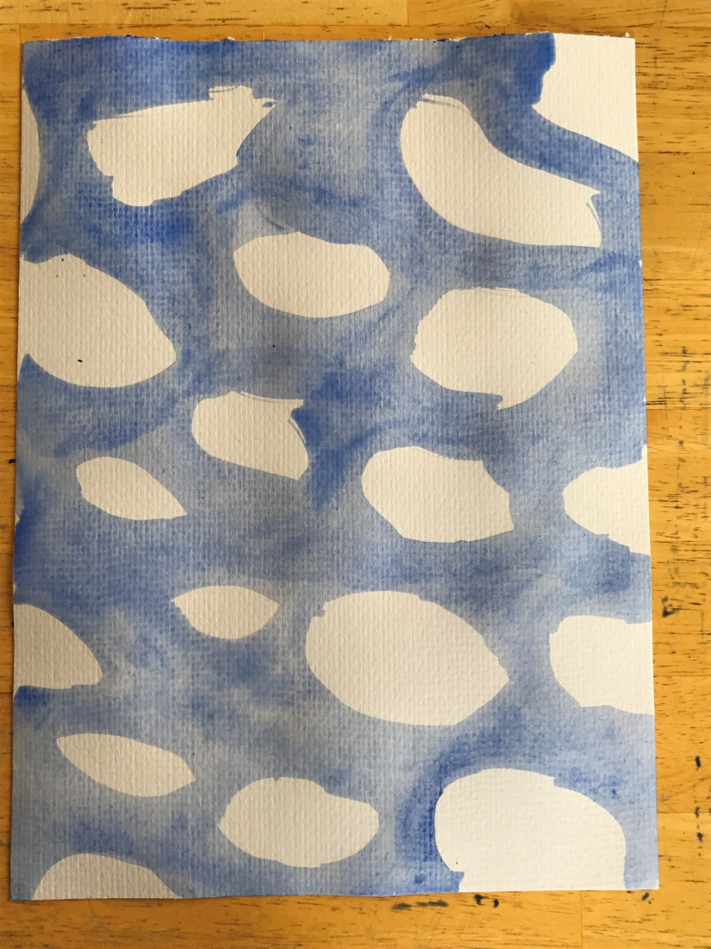
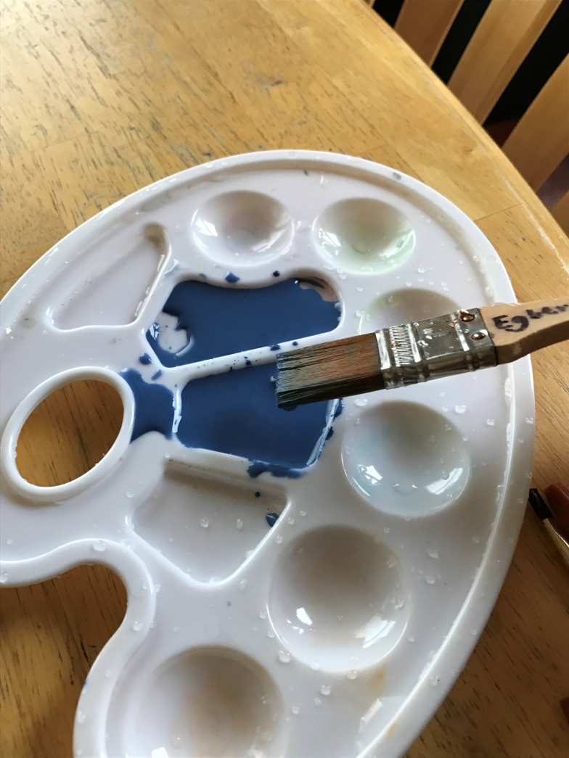
Step One: Mix water with blue paint and do a wash on the large sheet of paper, leaving white spaces for clouds.

Slide 5
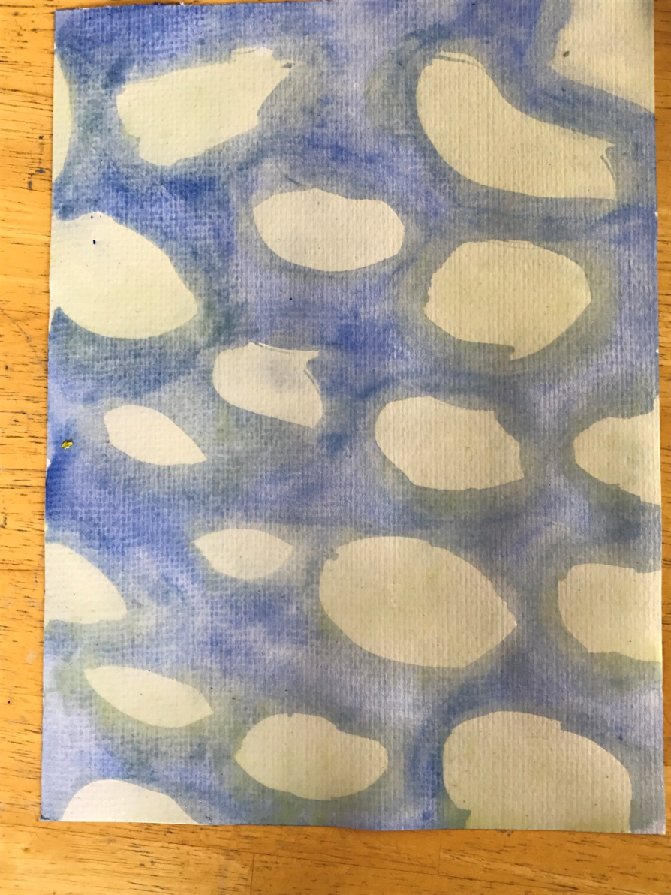
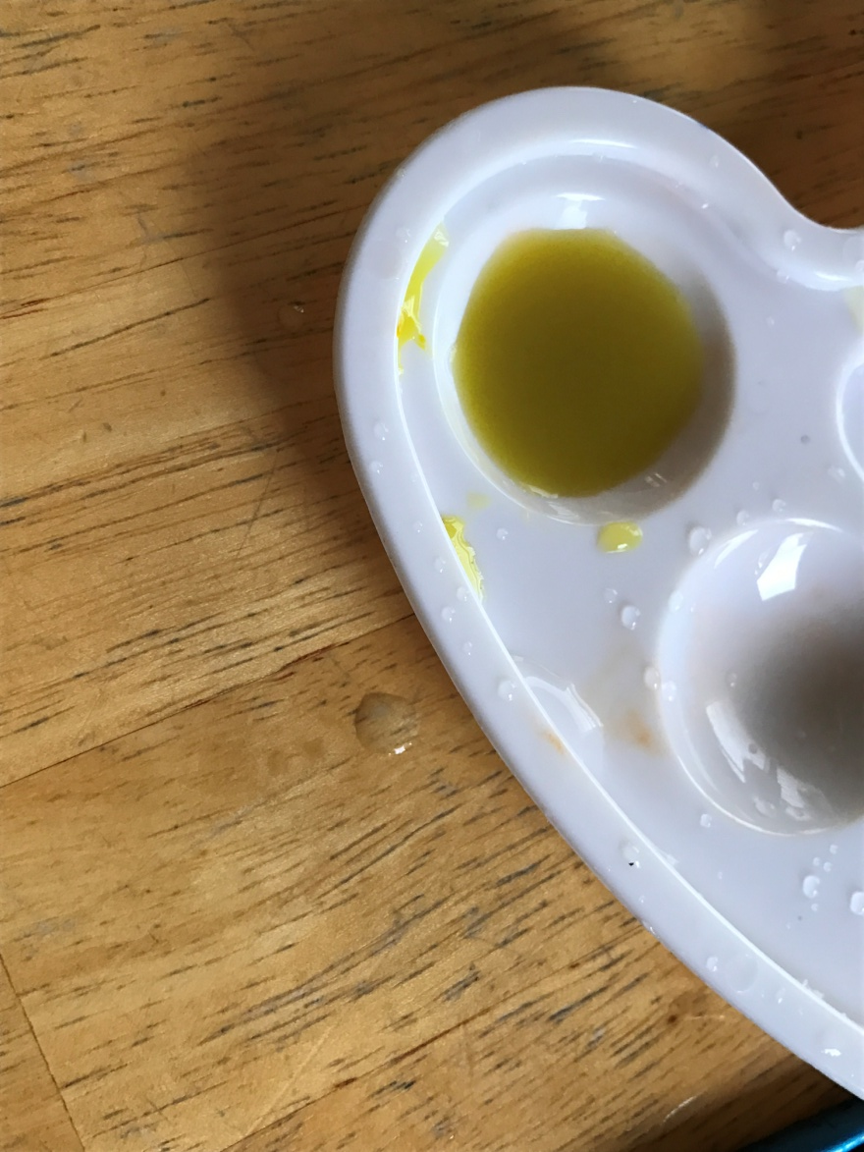
Step Two: Mix a tiny bit of yellow paint with plenty of water to make a pale yellow and brush it across the white parts of your sky.

Slide 6
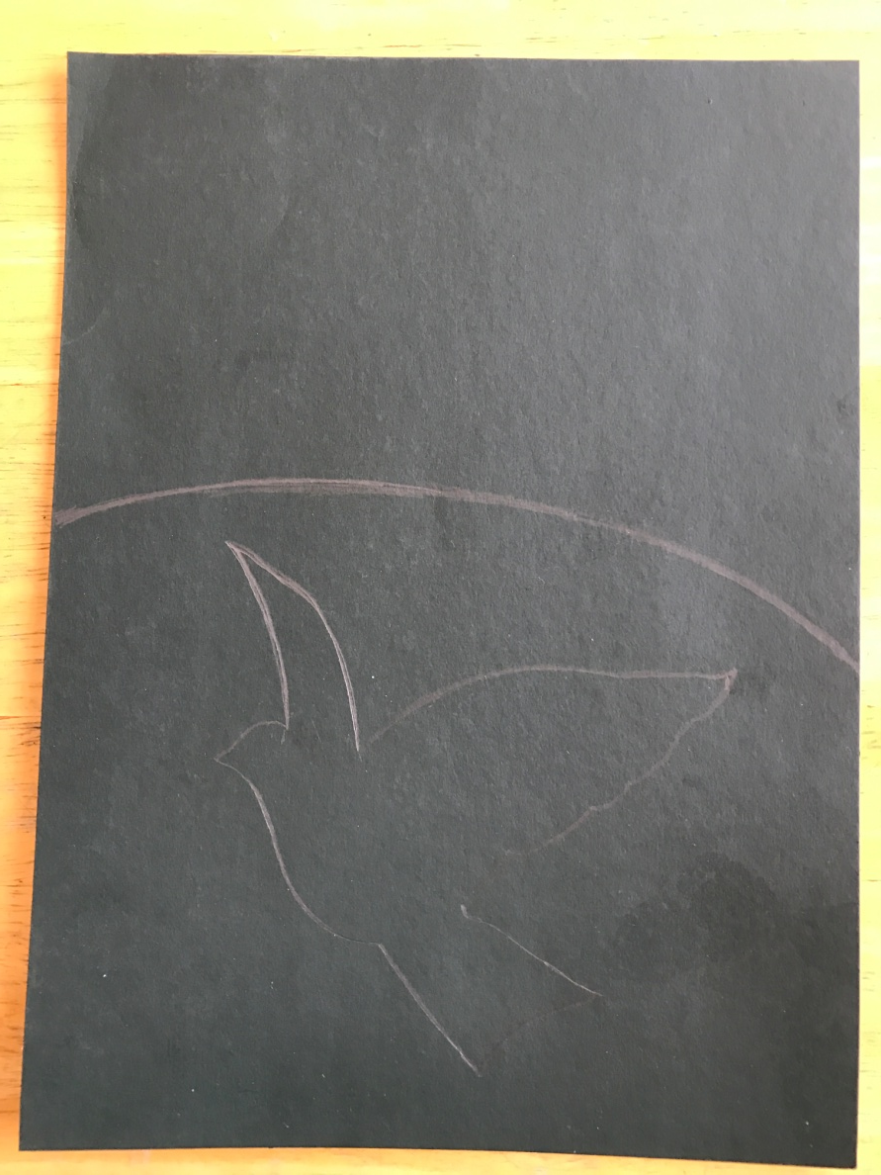
Step three: Draw a curved line dividing the black paper in half (or less) and draw the shape of a bird.

Slide 7
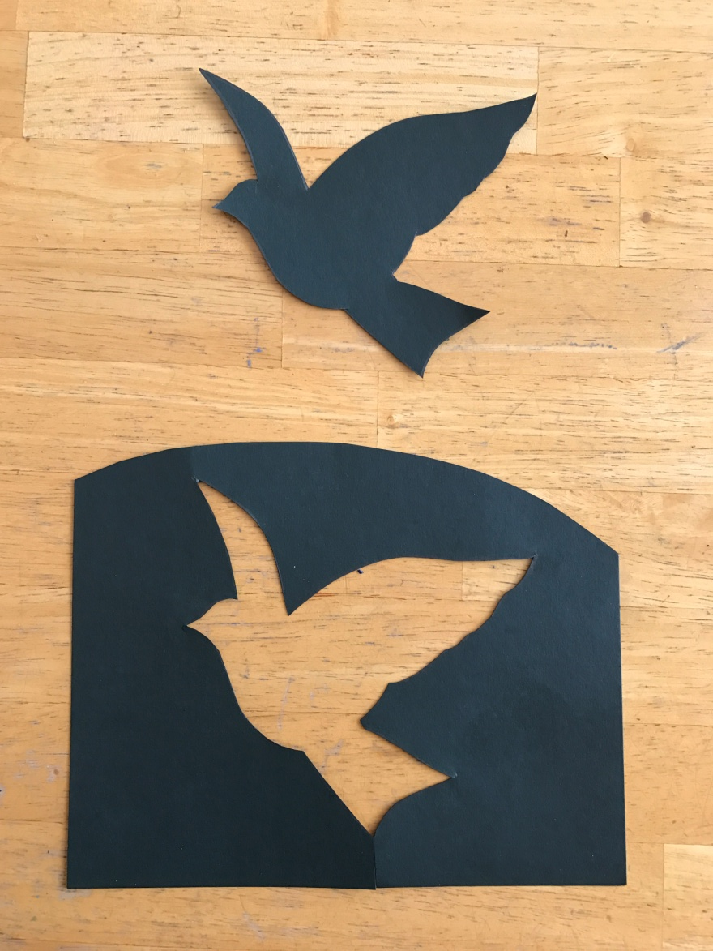
Step four: Cut along the horizontal line, then carefully cut out the bird, using only one entry point.

Slide 8
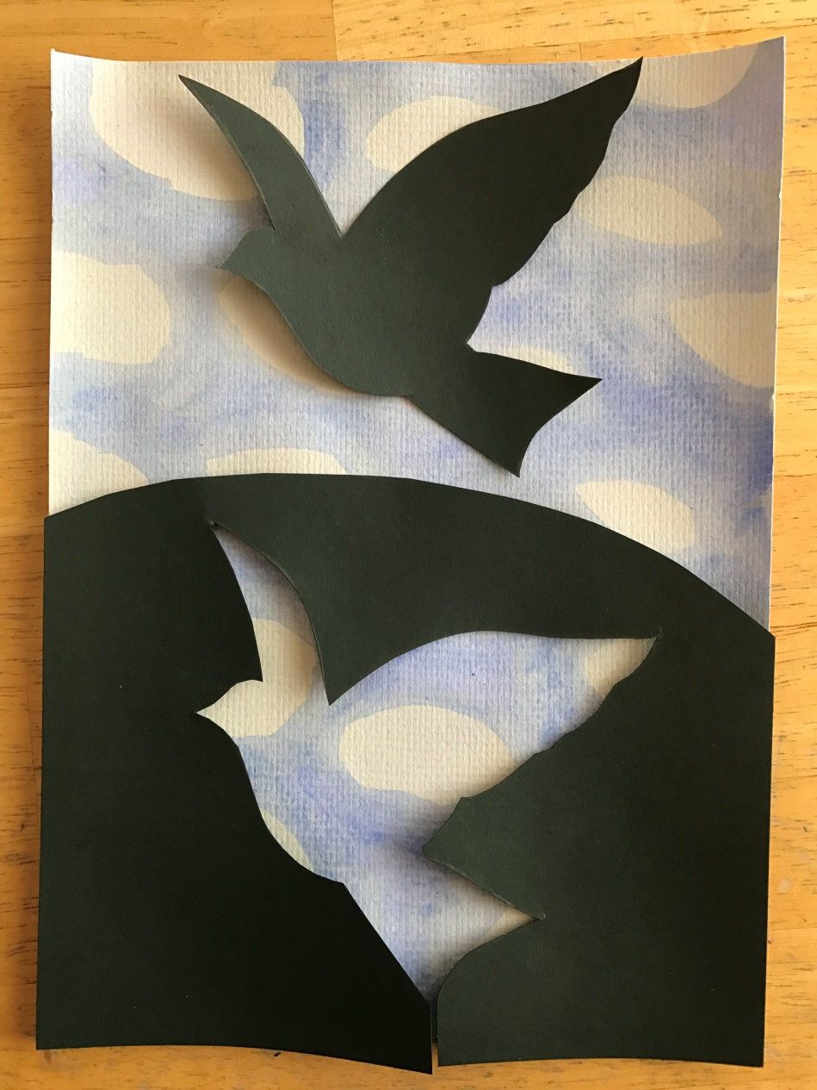
Step Five: Glue the portion with bird cut out to the bottom of your watercolor sky. Then glue the bird to the sky above.

