Slide 1
Rene Magritte
A Watercolor lesson on Positive and Negative Space

Slide 2
What is Positive and Negative Space? Simply put, positive space is best described as the areas in a work of art that are the subjects, or areas of interest. Negative space is area around the subjects, or areas of interest. The balance of positive and negative space is an important part of composition and the overall look of a work of art.

Slide 3
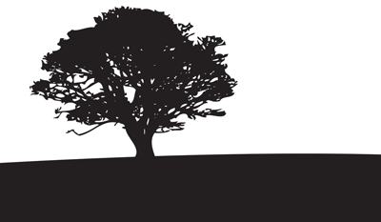
Which of these has equal parts positive and negative space? Which has more negative space? Positive space?

Slide 4
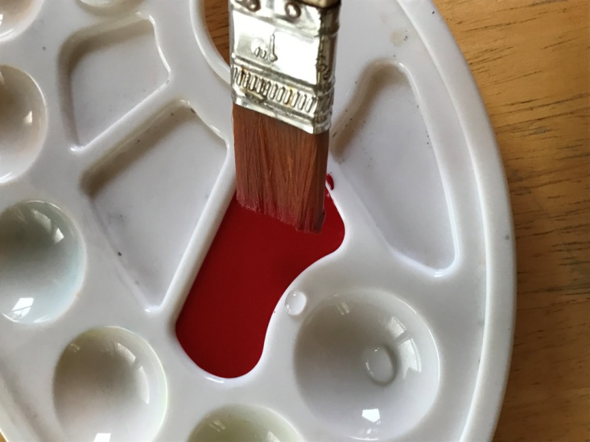
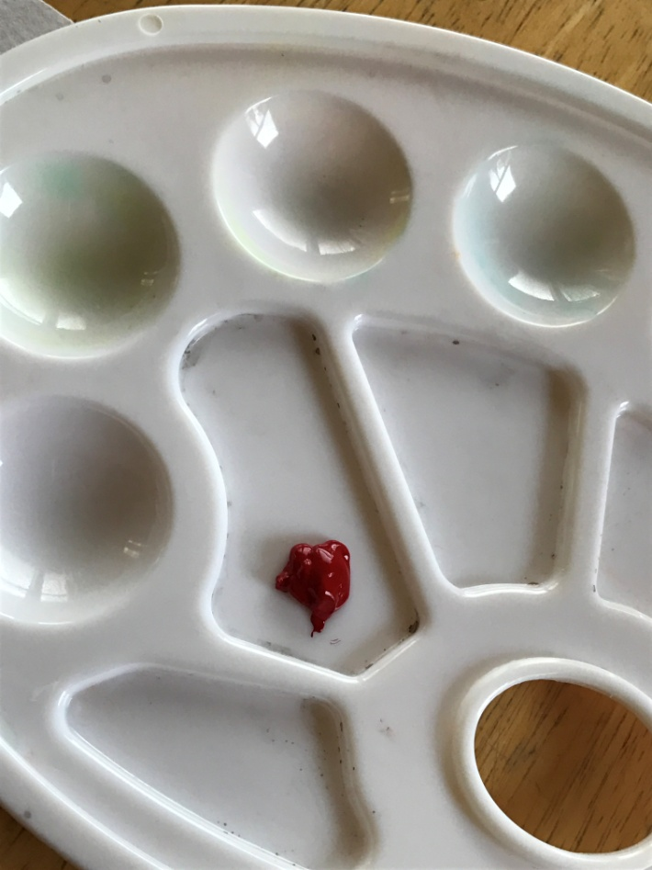
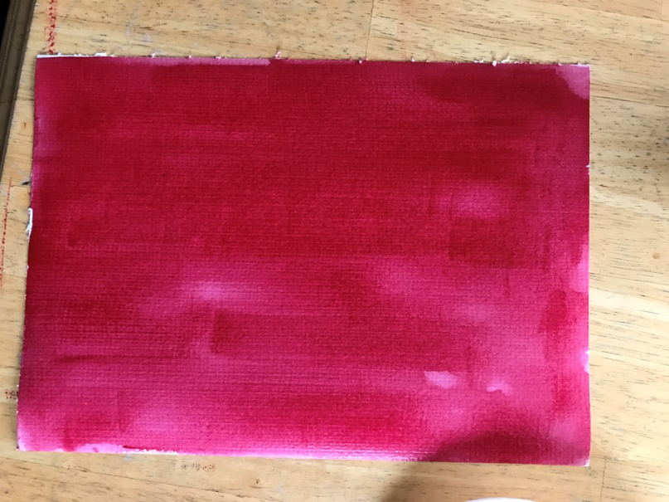
Step One: Mix a dab of red paint with water and use it to make a wash across the smaller sheet of paper.

Slide 5
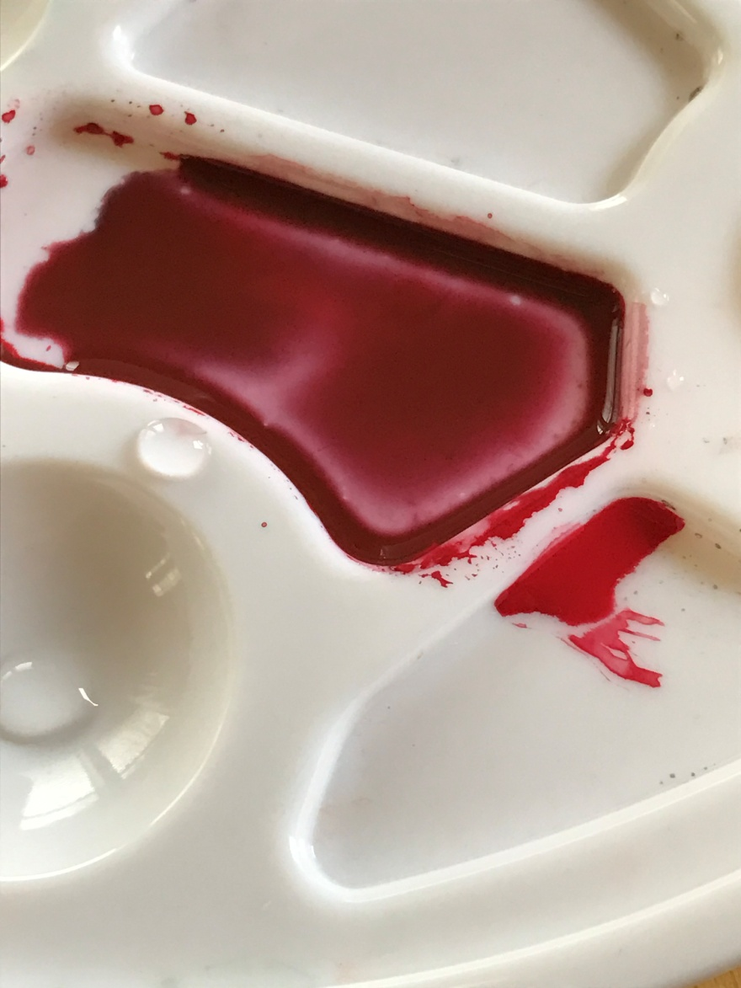
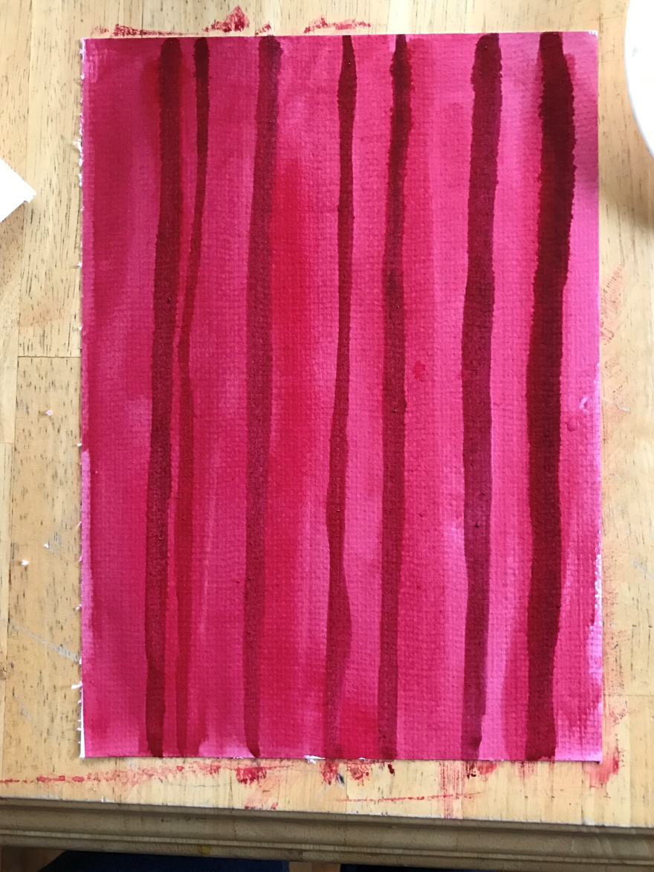
Step Two: Mix in a bit of black paint with the red and use to paint vertical lines (folds in the curtain).

Slide 6
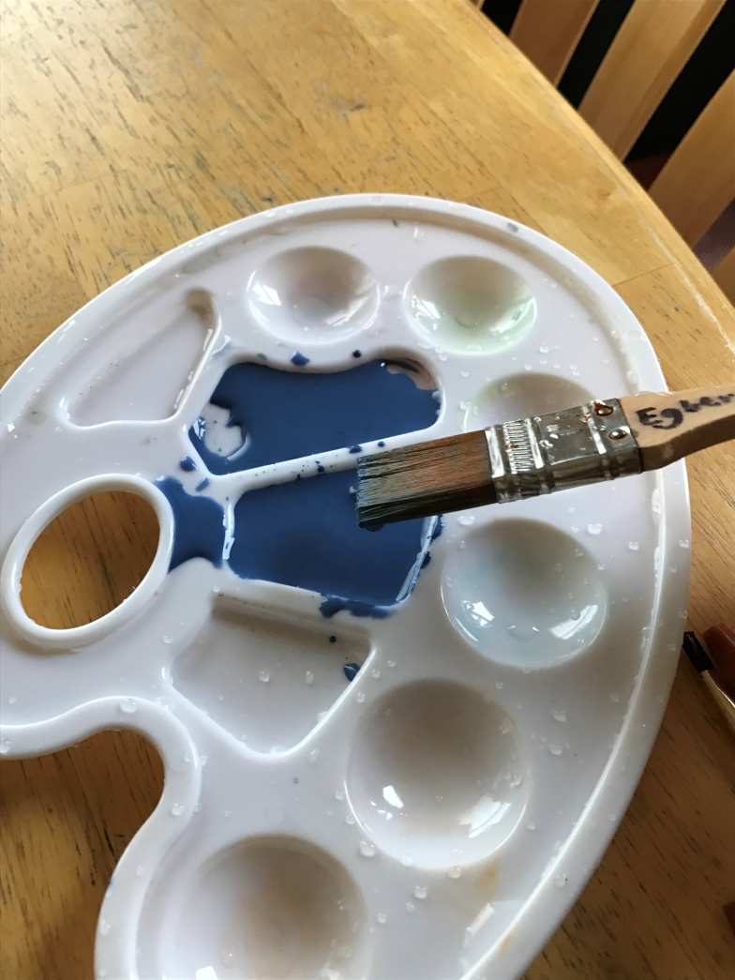
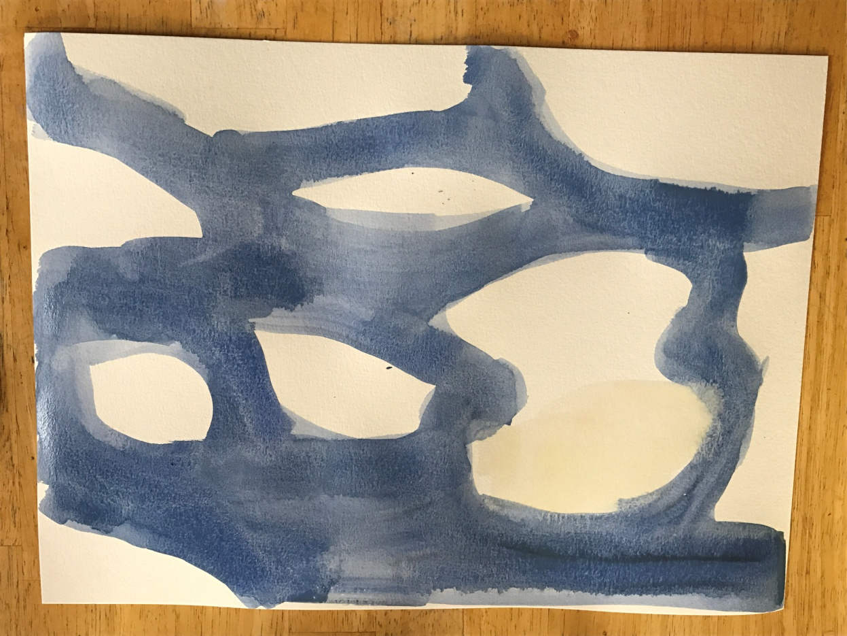
Step three: While that dries, Mix water with blue paint and do a wash on the large sheet of paper, leaving white spaces for clouds.

Slide 7
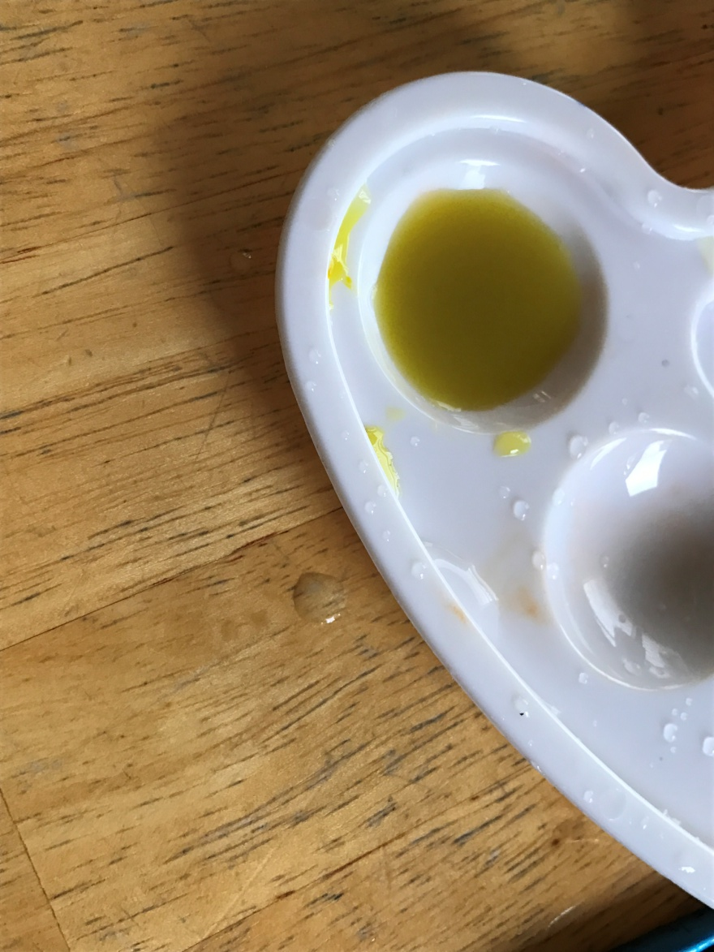
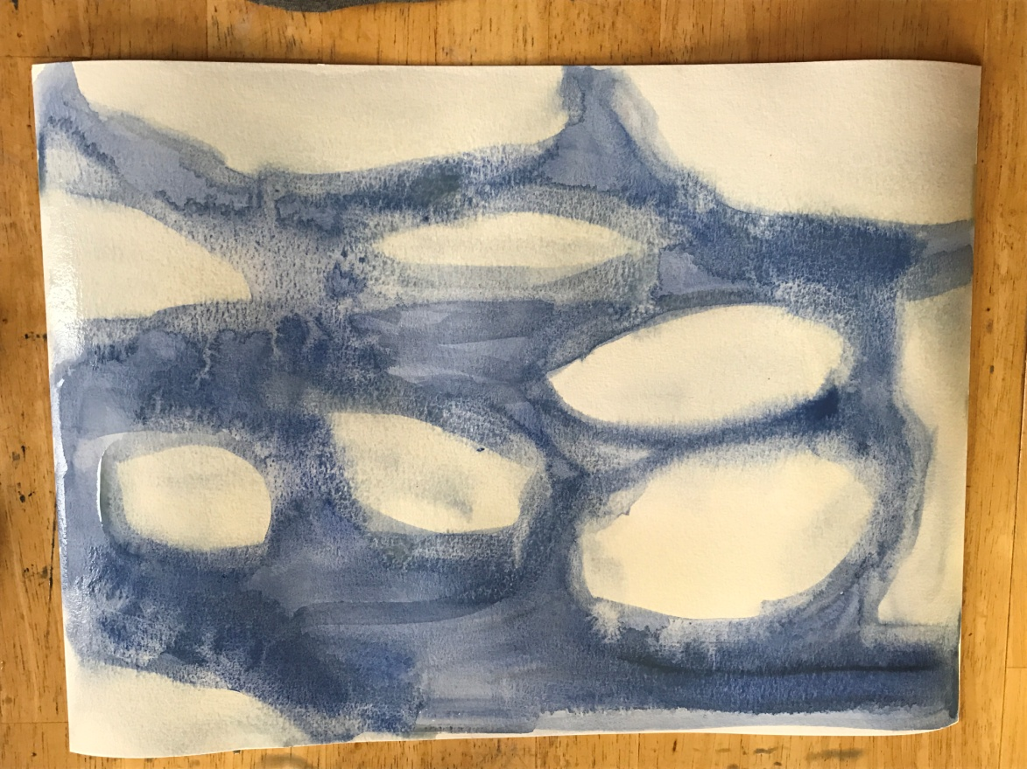
Step Four: Mix a tiny bit of yellow paint with plenty of water to make a pale yellow and brush it across the white parts of your sky.

Slide 8
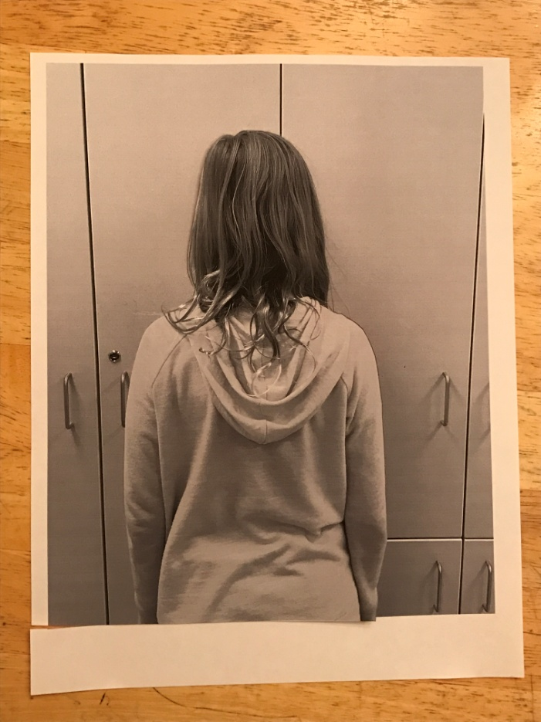
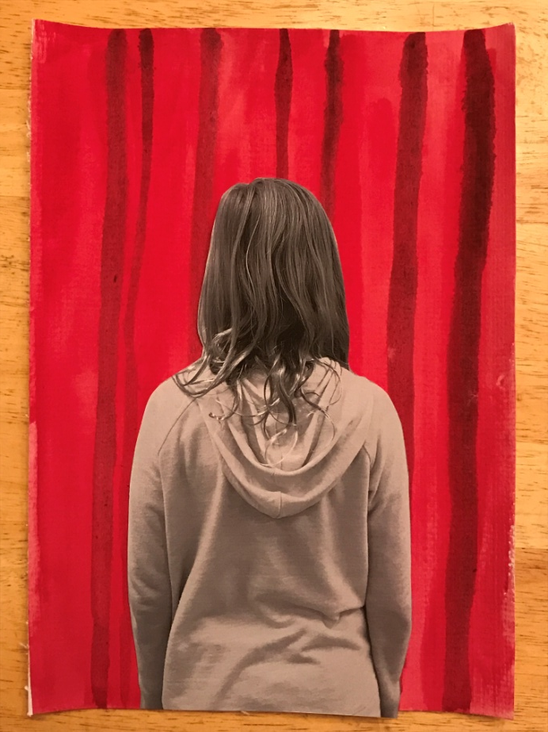
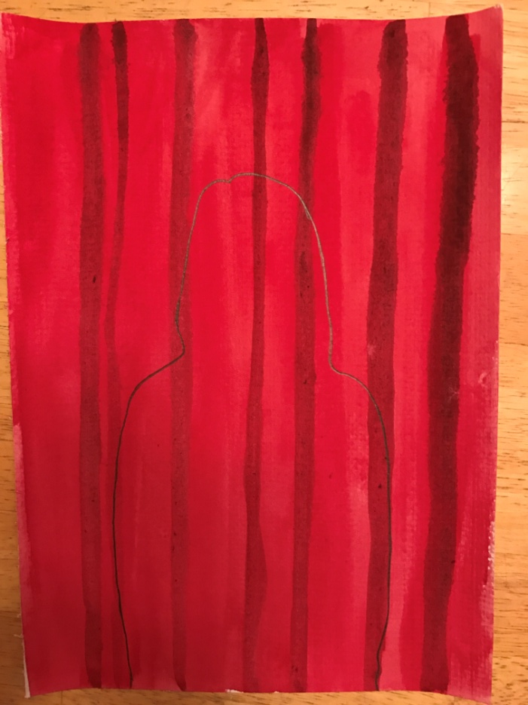
Step five: Cut the picture (around your body), lay it on the red paper, matching the bottom edges, and trace around it.

Slide 9
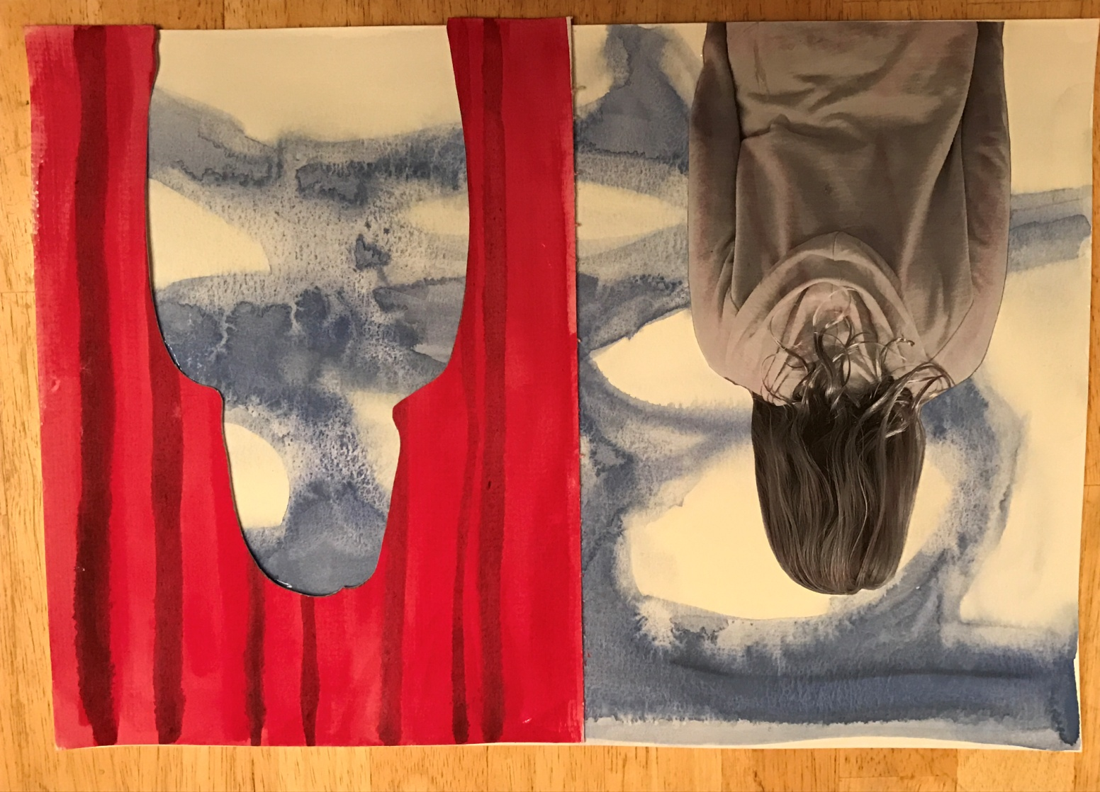
Step six: Cut along the traced lines, paste remaining “curtain” on right side of your blue paper and the body cut-out on the left side of the paper.

