Slide 1
Foil Snowflake Art
A Lesson in Symmetry and Relief Carving

Slide 2
Relief Sculpture – a method of sculpting where the sculpted elements remain attached to a solid background of the same material.
It gives the impression that the sculpted material has been raised above the background.

Slide 3
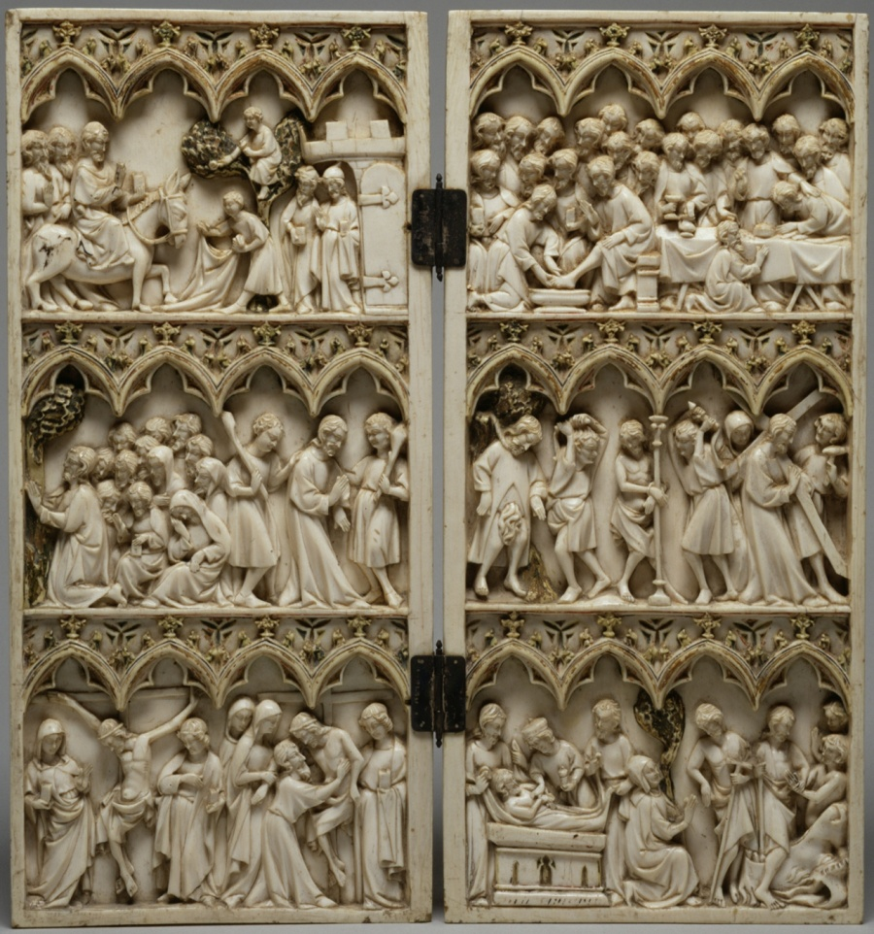
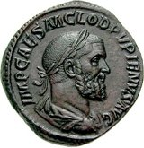
Most relief sculptures can be categorized by high relief
and low relief

Slide 4
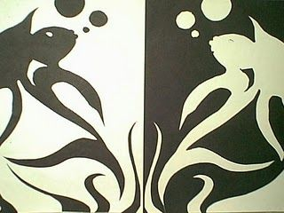
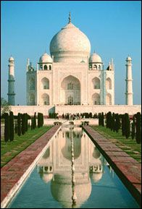
Symmetry – the quality of being made up of similar parts on or around an axis. In other words, if you were to draw a line through the center of your artwork, each side would mirror the other. Symmetry is used often to achieve balance in art and architecture.

Slide 5
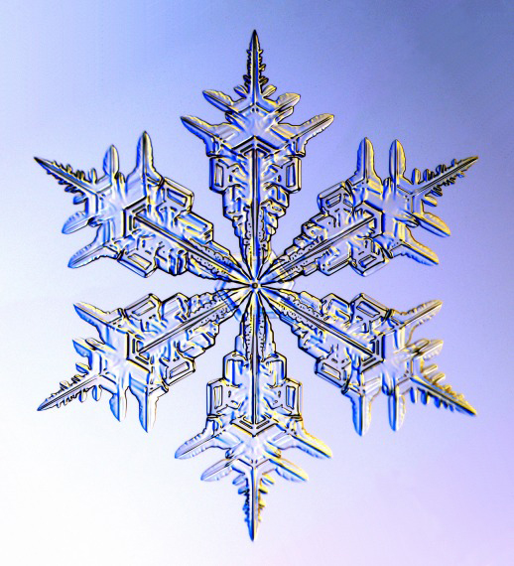
Snowflakes, though not perfectly symmetrical when found in nature, are a good example of symmetry in art. We will create our own relief sculpture of a snowflake to develop our sense of symmetry.

Slide 6
Step One: Take your piece of foil and bend the edges over the piece of cardboard.
This will give you a 5X5 inch square within which to “carve” your snowflake.

Slide 7
Step Two: Place your foil silver side down on the cardboard and, working from the center toward the outer edges, use a stylus to gently draw a symmetrical design of a snowflake.

Slide 8
Step Three: Turn your foil over and use the stylus to press outward on areas within your snowflake design. This will give the snowflake a raised or “relief” effect.

Slide 9
Step Four: Turning the foil over (colored side up), fold each edge over so that you have a contrasting edge to “frame” your snowflake.

Slide 10
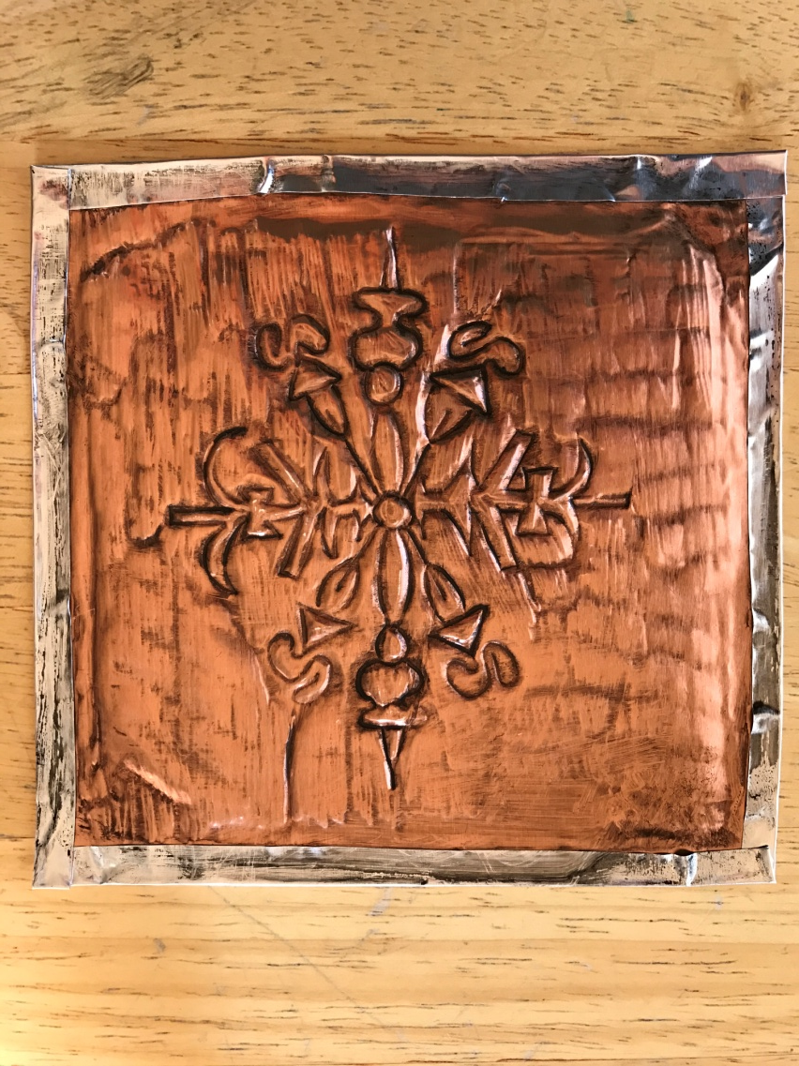
Step Five: Brush black shoe polish across your artwork, then wipe away with a paper towel, giving the piece an “antique” look.

Slide 11
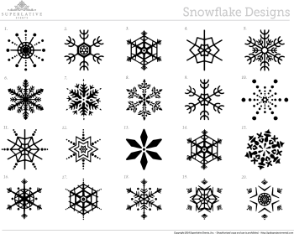
Here are some examples of symmetrical snowflake designs:

