Slide 1
100

Slide 2
200

Slide 3
300

Slide 4
400

Slide 5
500

Slide 6
100

Slide 7
200

Slide 8
300

Slide 9
400

Slide 10
500

Slide 11
100

Slide 12
200

Slide 13
300

Slide 14
400

Slide 15
500

Slide 16
100

Slide 17
200

Slide 18
300

Slide 19
400

Slide 20
500

Slide 21
100

Slide 22
200

Slide 23
300

Slide 24
400

Slide 25
500

Slide 26
Learning Resources

Slide 27
Young Women Classes

Slide 28
Themes and Symbols

Slide 29
Personal Progress

Slide 30
Miscellaneous

Slide 31
What is a device that is only to be used during Young Women or Mutual if you are accessing Gospel Library or texting someone to make sure they’re coming to the activity?

Slide 33
The curriculum for youth that is organized into monthly doctrinal topics and invites diligent learning.

Slide 34
What is the Come Follow Me curriculum?

Slide 35
You enter the Young Women program and become a member of the Beehive class at this age.

Slide 36
What is 12 years old?

Slide 38
What is the Beehive symbol?

Slide 39
“A young woman strengthens her faith in Heavenly Father and Jesus Christ and learns to work with others in harmony and cooperation. This is a time for her to stand for truth and righteousness and arise and shine forth.” is the motto for this class in Young Women.

Slide 40
What is the Beehive class?

Slide 41
The MIA in Mia Maids stands for this.

Slide 42
What is the Mutual Improvement Association, which was once the name of the youth program of the church?

Slide 43
The flower that is the symbol for he Mia Maids and represents love, faith and purity.

Slide 44
What is the rose?

Slide 45
The age at which a Young Woman enters the Mia Maid class.

Slide 46
What is 14 years old?

Slide 47
The leaves of this tree symbolize honor and accomplishment, particularly when woven into a crown.

Slide 48
What is the laurel tree?

Slide 49
A young woman becomes a member of the Laurel class at this age.

Slide 50
What is 16 years old?

Slide 52
What is the Young Women symbol and motto?

Slide 53
These eight values are Christlike attributes and are used in Sunday gospel instruction, Personal Progress and Mutual Activities to help each young woman apply them in her life.

Slide 54
What are Faith, Divine Nature, Individual Worth, Knowledge, Choice and Accountability, Good Words, Integrity and Virtue?

Slide 55
The booklet in which the First Presidency outlines gospel standards and teaches youth how to apply them.

Slide 56
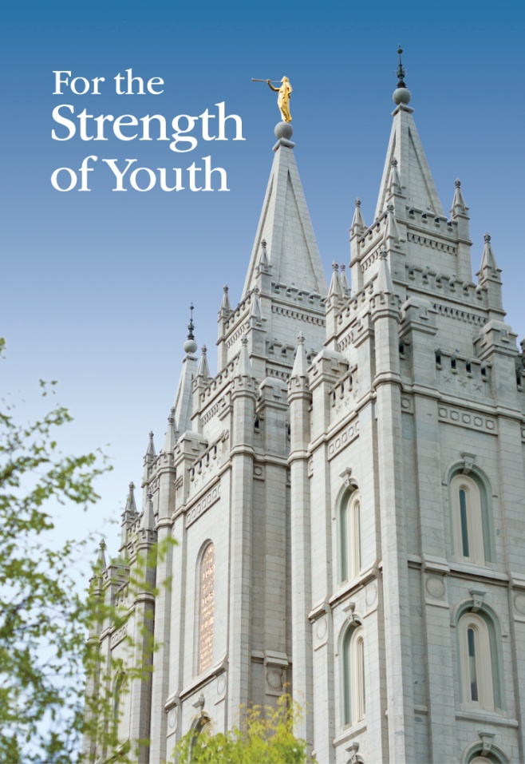
What is For the Strength of Youth?

Slide 57
The achievement program designed to help young women strengthen their testimonies of Jesus Christ, prepare for their future roles, and prepare to be worthy to make and keep sacred covenants.

Slide 58
What is Personal Progress?

Slide 59
The 2017 Mutual Theme (scripture reference)

Slide 60
What is James 1:5-6?

Slide 61
This book is designed as a companion to studying the scriptures and the teachings of latter-day prophets. It contains brief, simple statements on gospel doctrines and principles, arranged alphabetically.

Slide 62
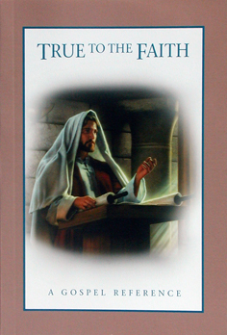
What is True to the Faith?

Slide 63
A statement of faith that young women repeat every Sunday during opening exercises as well as at other Young Women gatherings.

Slide 64
What is the Young Women Theme?

Slide 65
The number of experiences a young women must complete in each value(except Virtue) of the Personal Progress program.

Slide 66
What is six?

Slide 67
The minimum number of hours a young woman spends to complete a value project in Personal Progress.

Slide 68
What is ten?

Slide 69
The picture on the Young Woman Medallion you receive after completion of the Personal Progress program.

Slide 70
What is the temple?

Slide 71
Each young woman is given one of these to use to take notes and record assignments during Sunday lessons.

Slide 72
What is a notebook or journal?

Slide 73
The day and time at which we meet for Mutual weekday activities.

Slide 74
What is…?

Slide 75
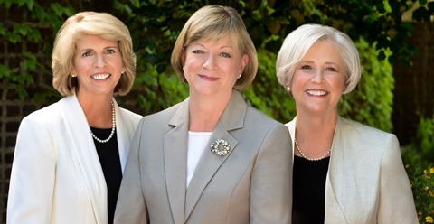
Sister McConkie, Sister Oscarson, and Sister Marriott

Slide 76
Who are the General Young Women Presidency of the church?

Slide 77
An annual event where young women draw closer to God in nature, develop skills and build friendships.

Slide 78
What is Young Women Camp?

Slide 79
Who are the Young Women Presidency and Advisers?

Slide 80
Names of your ward YW leaders

