Slide 1
Renoir Umbrellas
A Lesson in Value

Slide 2
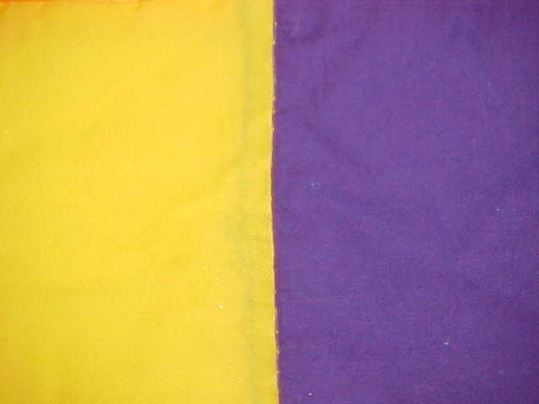
Value
Value refers to the lightness or darkness of a color.
For example, yellow is a light value and purple is a dark value.

Slide 3
Tint
By adding white, you can change the value of a color. It is now a lighter value.
Adding white to any color is a tint.

Slide 4
Shade
By adding black, you have changed the value of the original color. It now has a darker value.
Adding black to any color is a shade.

Slide 5
Renoir’s painting The Umbrellas demonstrates a vast range of values of the color blue. What do different values of the same color add to the painting?

Slide 6
We will attempt to paint a single umbrella using different values of the same color, much as Renoir did. Step One: Draw an umbrella.

Slide 7
Step Two: Add a bit of your chosen color paint to the white paint and mix well. Use this to paint the center of the umbrella.

Slide 8
Step Three: Add a bit more colored paint to the white and paint another section toward the outer edges of the umbrella. Feel free to blend the edges of each tint so that the transition isn’t drastic.

Slide 9
Step Four: Add color and mix 1-2 more times until you reach your original color.

Slide 10
Step Five: Begin adding black to your original color and paint the rest of the outside of the umbrella in increments.

Slide 11
Step Six: Add more black and paint the underbelly of the umbrella in this darker shade.

Slide 12
Step Seven: Add black to create a darker shade and use it to paint your umbrella stem.

Slide 13
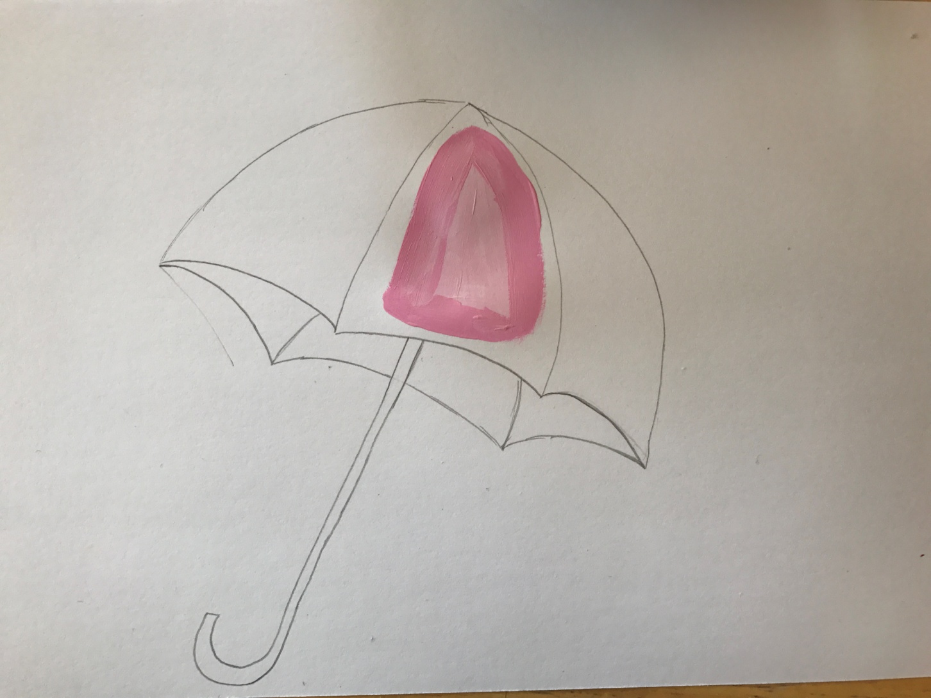
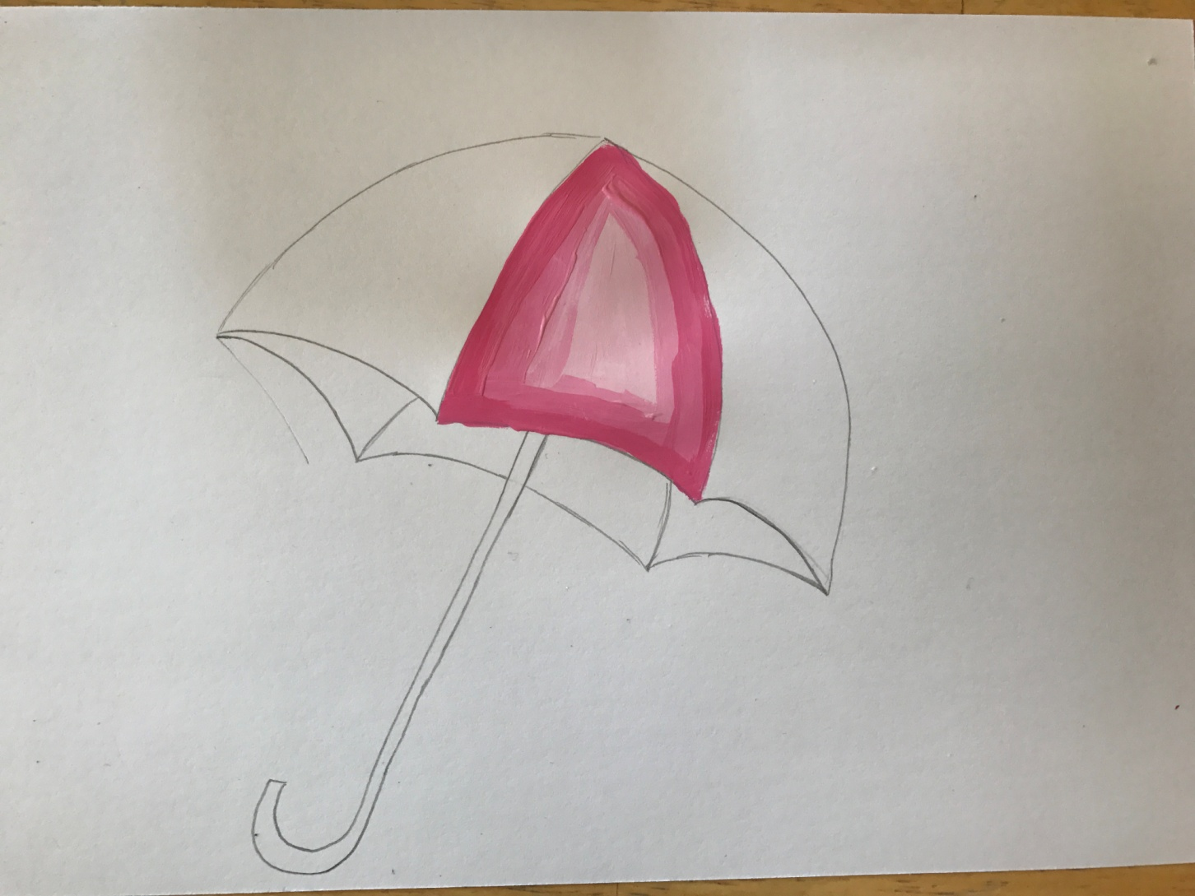
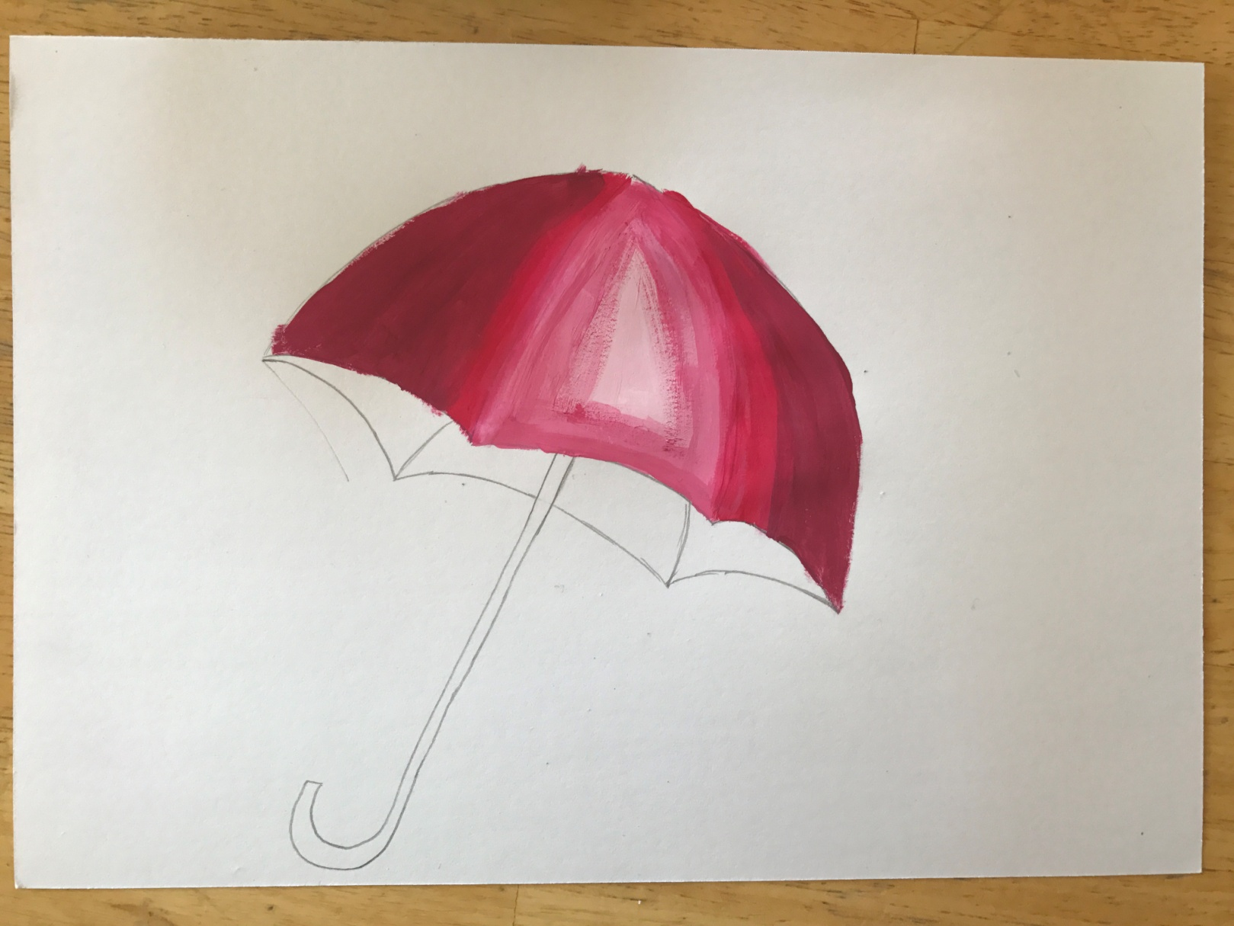
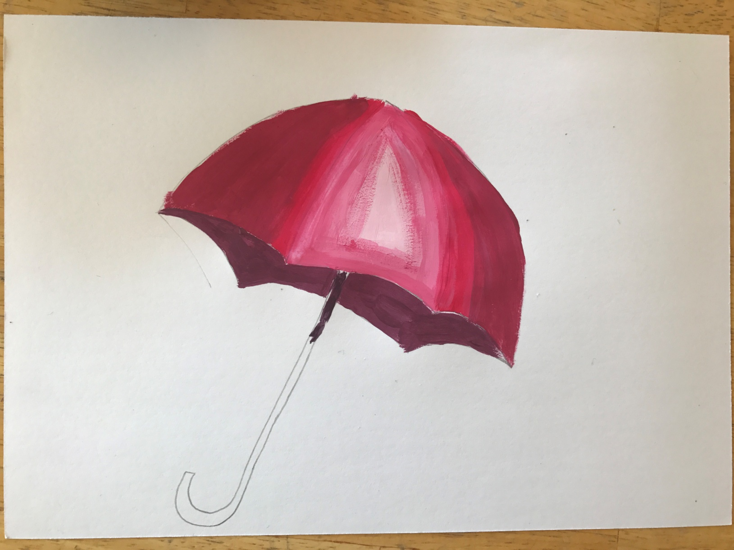
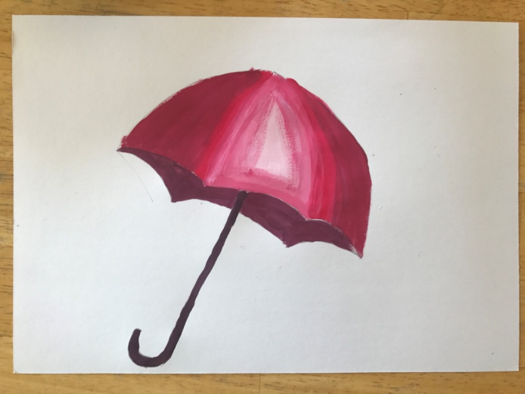
Summary:

