Slide 1
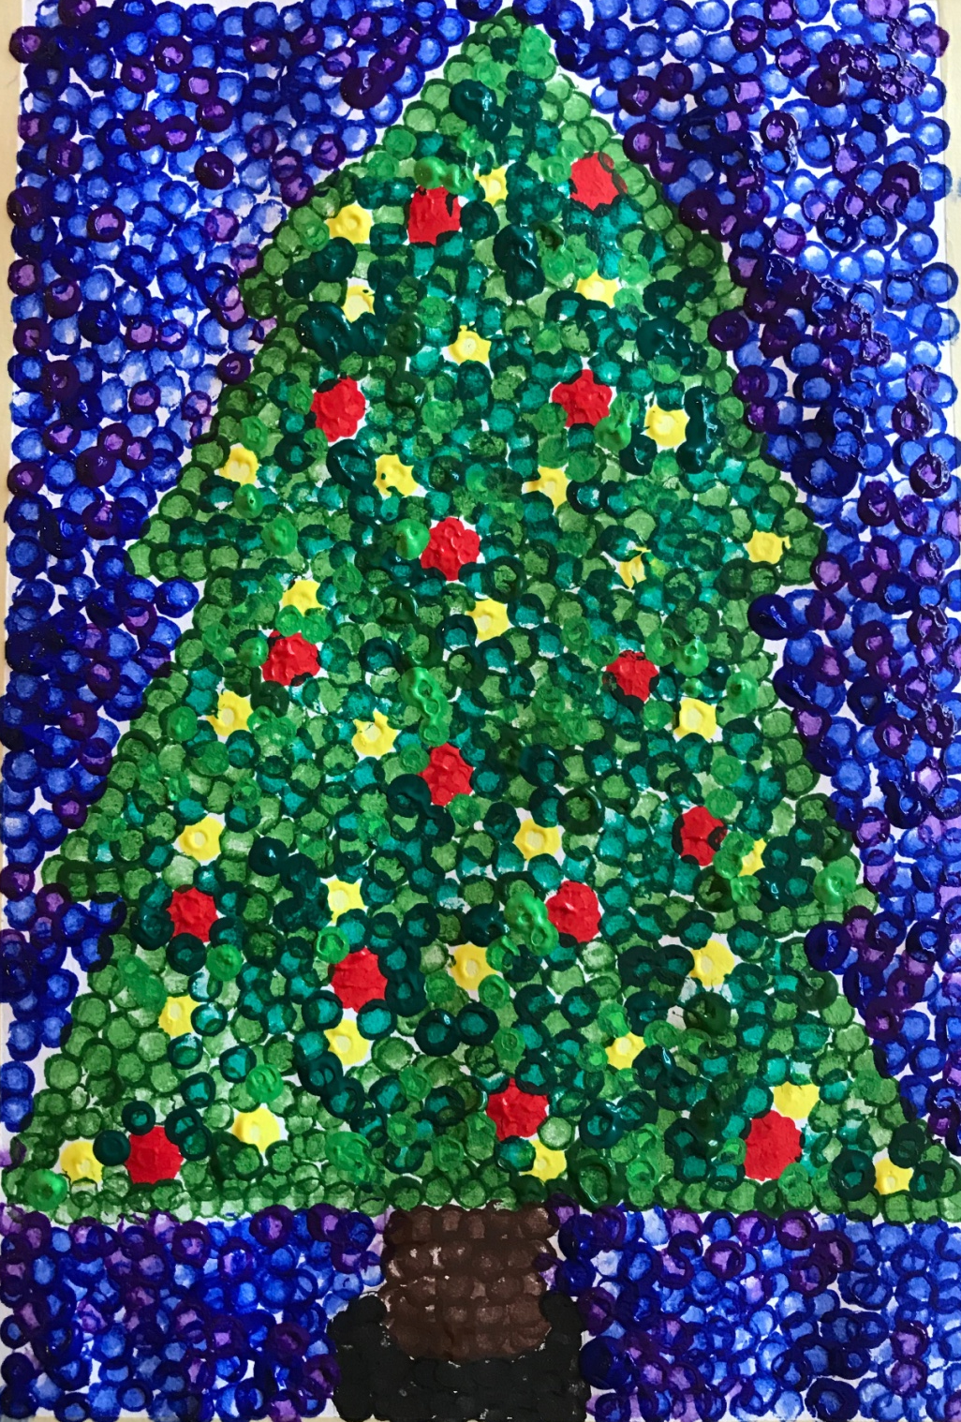
Holiday Pointillism
In the style of Georges Seurat

Slide 2
Just as Georges Seurat used tiny dots of paint to force the eye to “blend” the colors together, we will use the same method called Pointillism to create a holiday-style painting.

Slide 3
Step One: Lightly draw a simple outline of a holiday symbol (star, tree, wreath, menorah, etc.) It should take up most of your paper.

Slide 4
Step two: Dip a cotton swab in paint and begin filling in your drawing, painting the small details first. For example, the lights and decorations on the Christmas tree.

Slide 5
Add more details, if necessary.

Slide 6
Step three: Pick a color to use as the main color to fill in your drawing. Using a cotton swab, apply dots of this color to the picture.

Slide 7
Step Four: Fill the white spaces in with varying shades of color.

Slide 8
Step Five: Fill in the rest of the details of the drawing with your chosen color(s) of paint.

Slide 9
Step six: Fill in the background with varying shades of a contrasting color of paint.

Slide 10
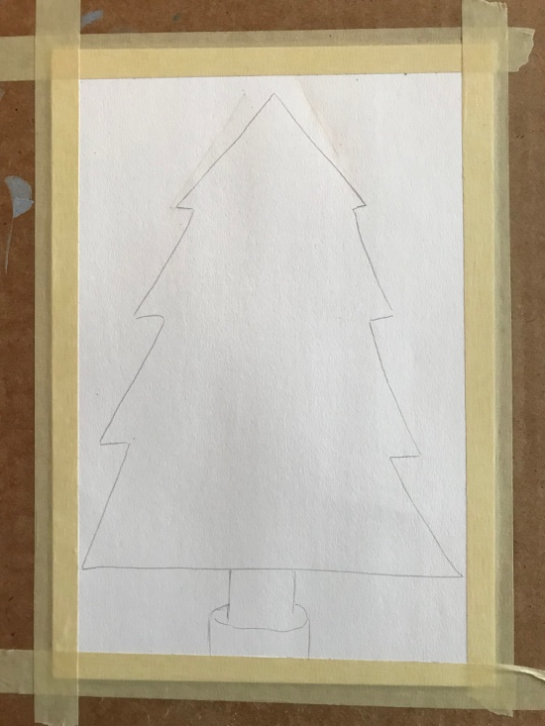
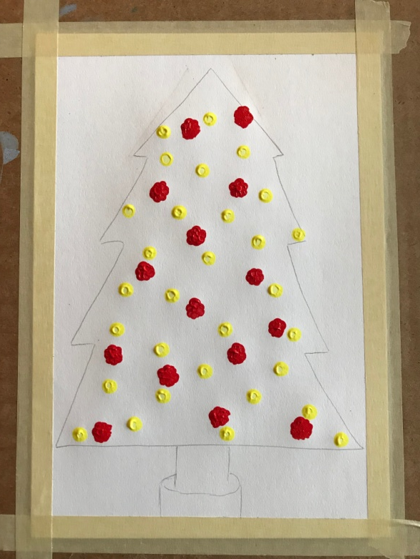
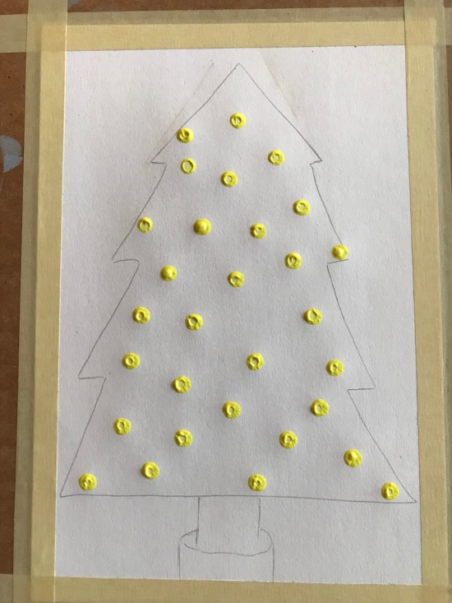
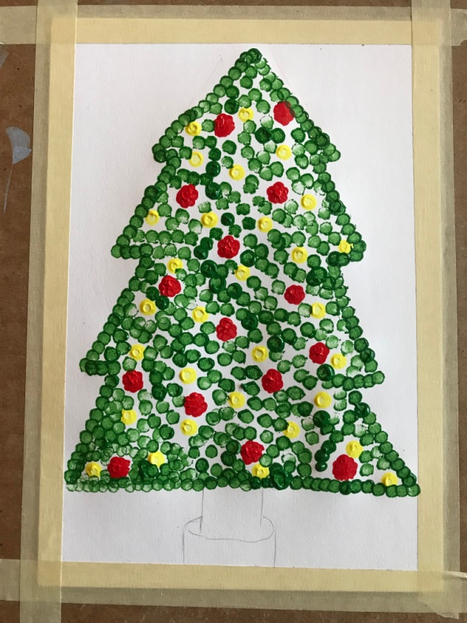
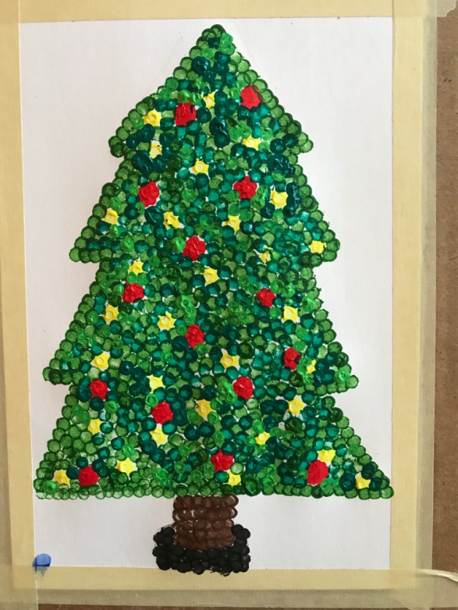
Summary:
1
2
3
4
5
6

