Slide 1
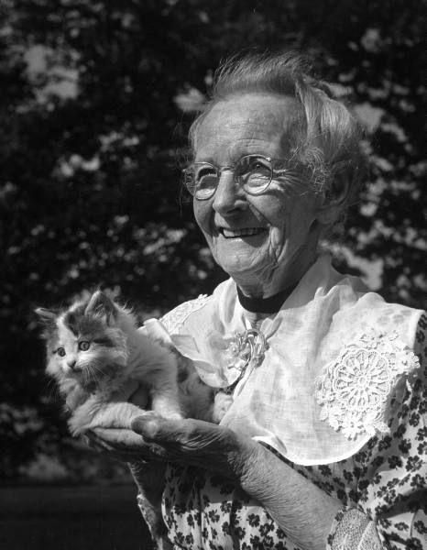
Grandma Moses
1860- 1961

Slide 2
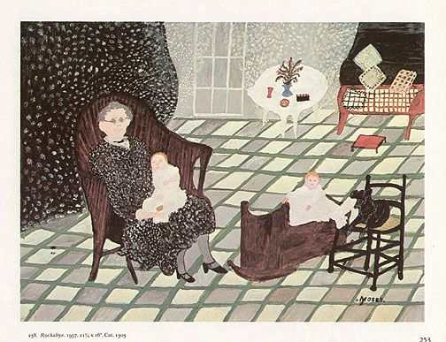
Folk Art
Anna Mary Robertson
Farm in Greenwich, NY
She loved to draw as a kid but paints and colors were expensive and hard to find.
She did not start painting serious until in her late 60s
Learned to draw and paint all on her own.
She painted mostly landscapes of farms, rolling mountains, towns
She painted people doing things

Slide 3
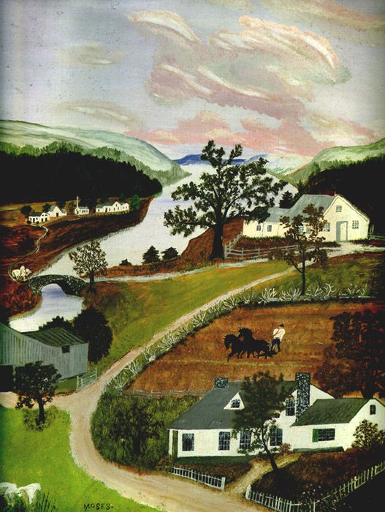
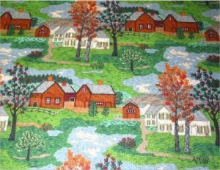

Slide 4
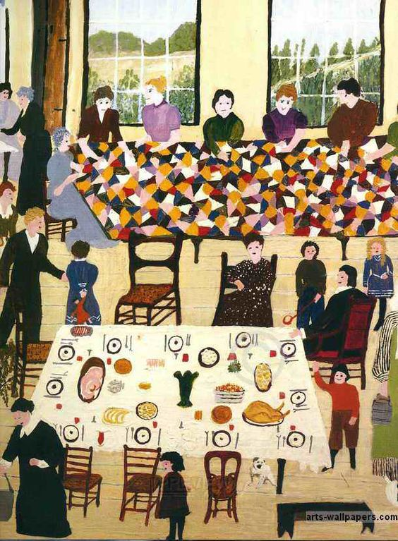
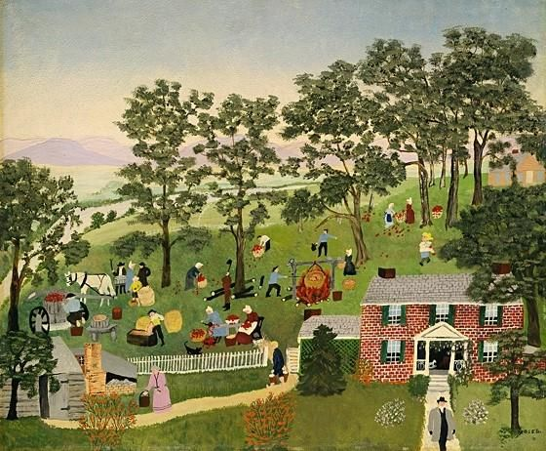

Slide 5
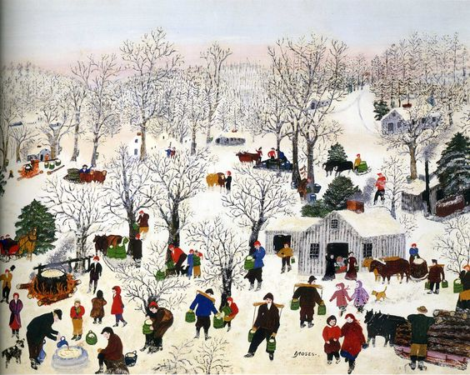

Slide 6
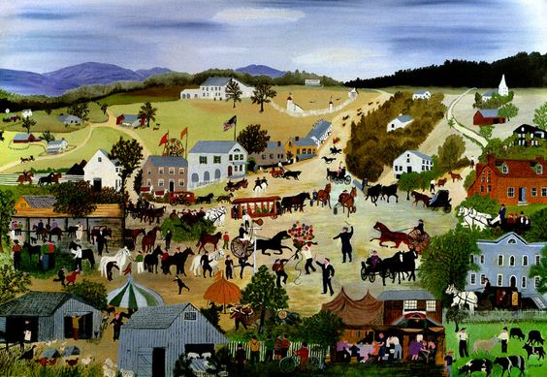

Slide 7
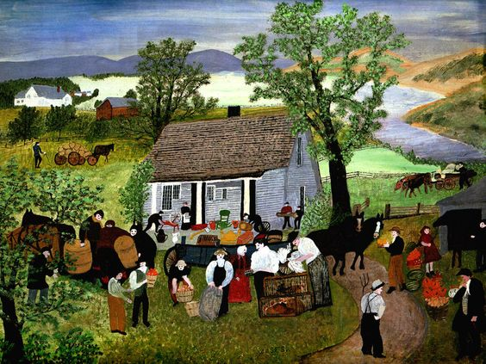
By the time she was 80 years old, many people had heard of "Grandma Moses" and had seen her paintings. Paintings which she first sold for about $5 later were sold for $8,000 to $10,000.

Slide 8
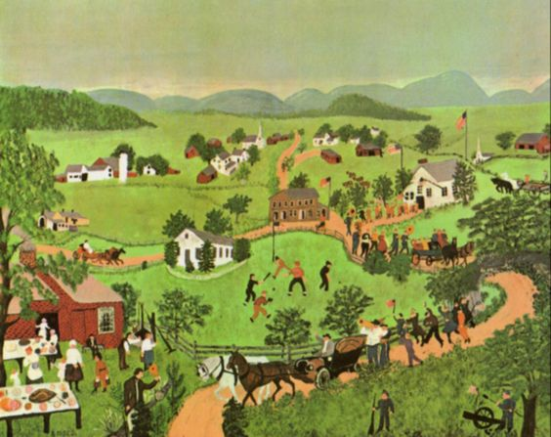
People liked Grandma Moses as much as they liked her paintings. She was friendly and fun to talk to. Her paintings reminded everyone of simpler, happier times.

Slide 9
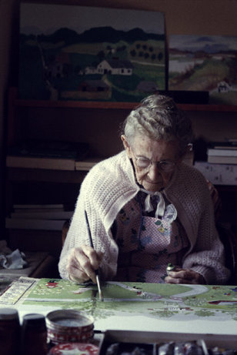
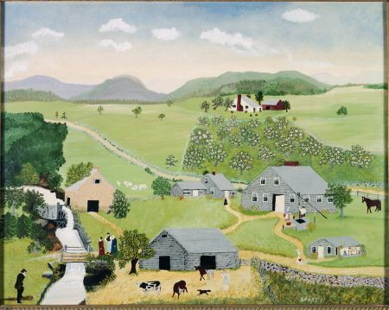

Slide 10
Horizon Line/eye level: a physical/visual boundary where sky separates from land or water. It is the actual height of the viewer's eyes when looking at an object, interior scene, or an exterior scene.
Can you find the horizon line in these pictures?

Slide 11
Can you find it in these?

Slide 13
Now let’s discuss foreground, middle ground and background. Where would you place each of these cars in the picture?

Slide 14
Notice that objects appearing in the foreground are larger than those in the middle ground and background.
Background
Middle ground
Fore ground

Slide 15
Let’s apply these principles to our own work of art in the style of Grandma Moses.
Step One: Using a pencil, lightly draw a horizon line in the top half of your paper.

Slide 16
Step Two: Using watercolor pencils, draw objects in your background (mostly above the horizon line). Shade them in lightly.

Slide 17
Step Three: Add a few objects to the foreground and shade them in.

Slide 18
Step Four: Fill in the middle ground with a variety of objects. Your drawing should include the following:
1. At least one building.
2. At least two people doing something.
3. At least three animals.
4. At least four trees (or groups of trees)
5. At least one path or stream.

Slide 19
Step Five: Dip your small brush in water and blend the pencil marks on the smaller objects in your drawing. Remember to use as little water as possible and to rinse your brush in between colors.

Slide 20
Step Six: Dip your large brush in water and blend the pencil marks on the other areas of your drawing (the fields, hills, trees, sky, etc.) Remember again to clean brush in between colors.

Slide 21
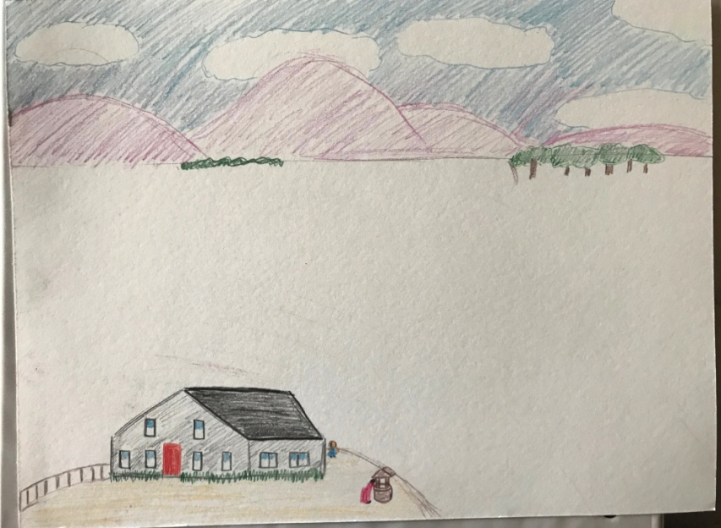
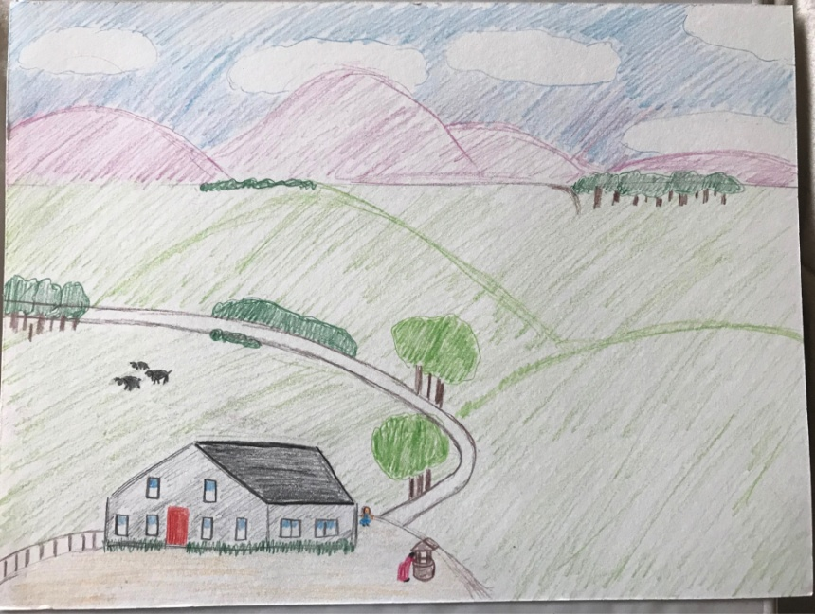
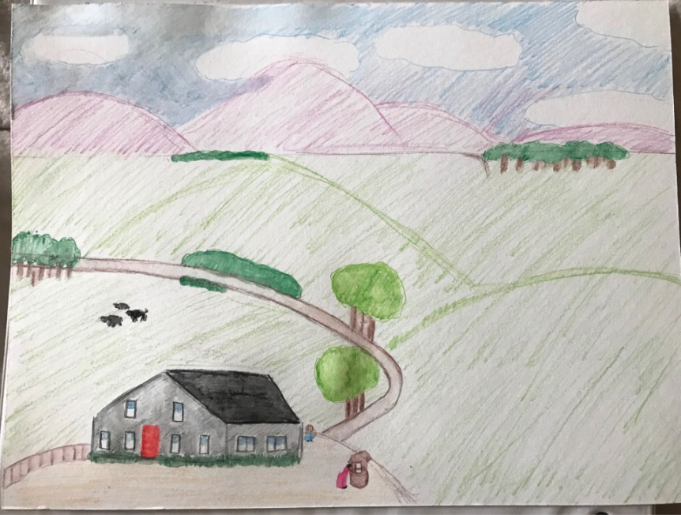
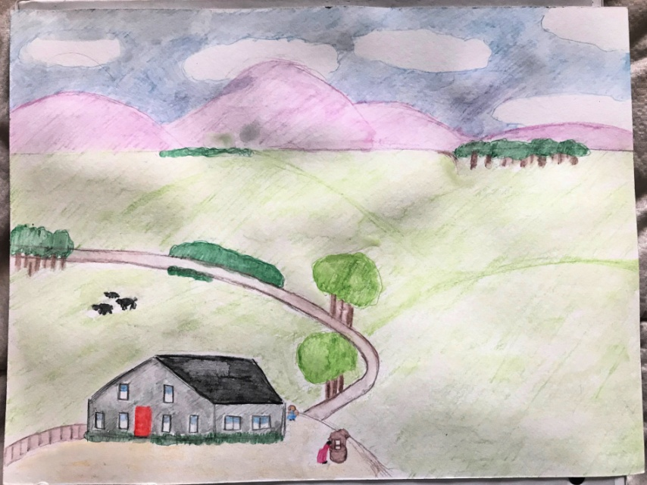
Summary:
1. Draw horizon line.
2. Draw background.
3. Draw foreground.
4, Draw middle ground.
5. Use water to blend pencil marks on small objects.
6. Blend larger objects using large brush.

