Slide 1
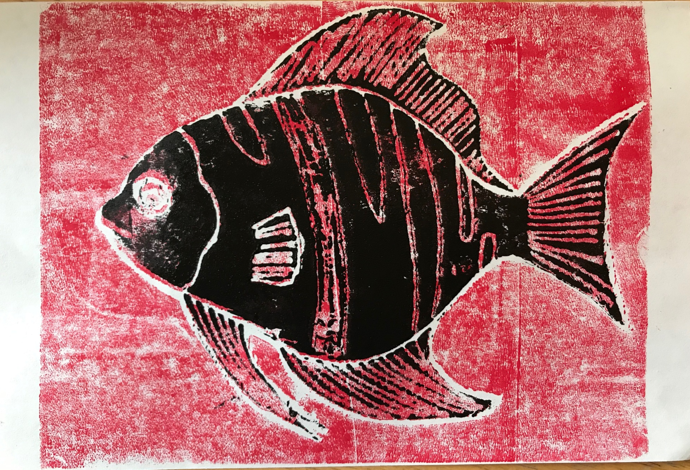
Sea Life Print

Slide 2
Use your stick to “draw” an outline of a fish. Keep it simple – save the details for later.

Slide 3
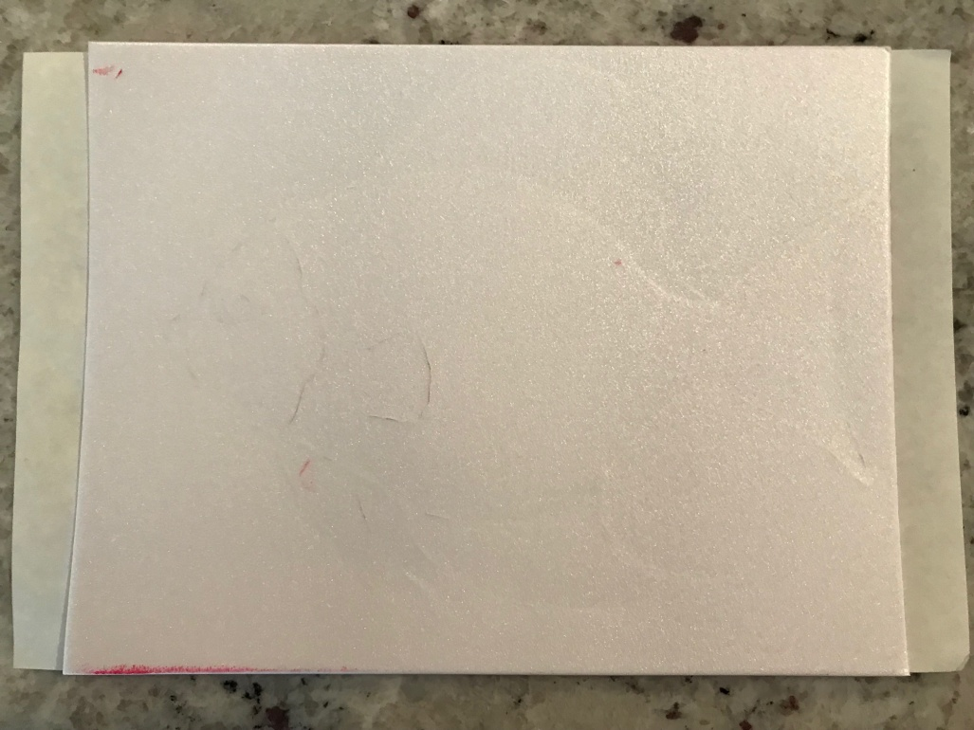
Roll out ink onto the foam and place foam on your paper. Press firmly across the entire paper.

Slide 4
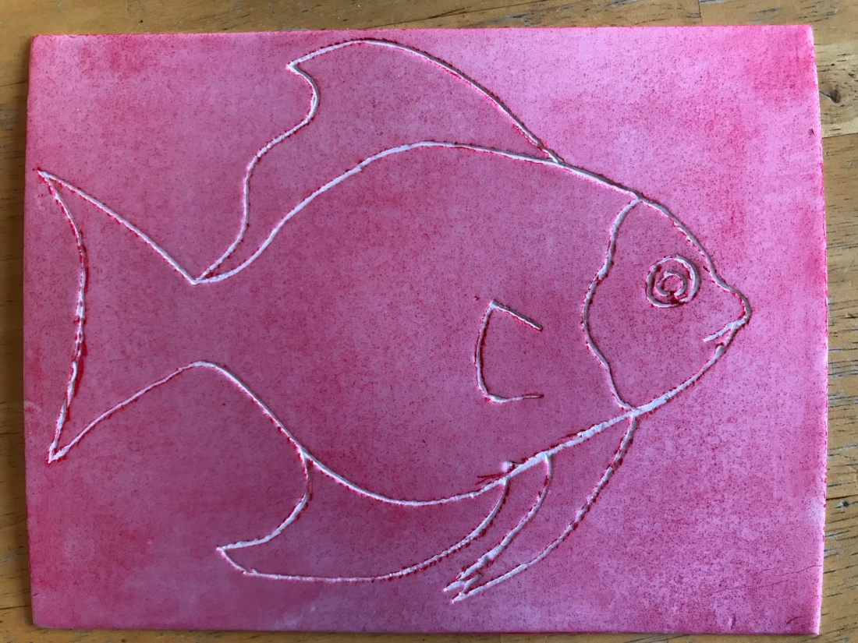
Separate the foam from the paper and wipe excess ink from the foam.

Slide 5
Use stick to add details to your drawing. Then, use scissors to cut it out.

Slide 6
Using a brayer, apply an even coat of black paint to the foam.

Slide 7
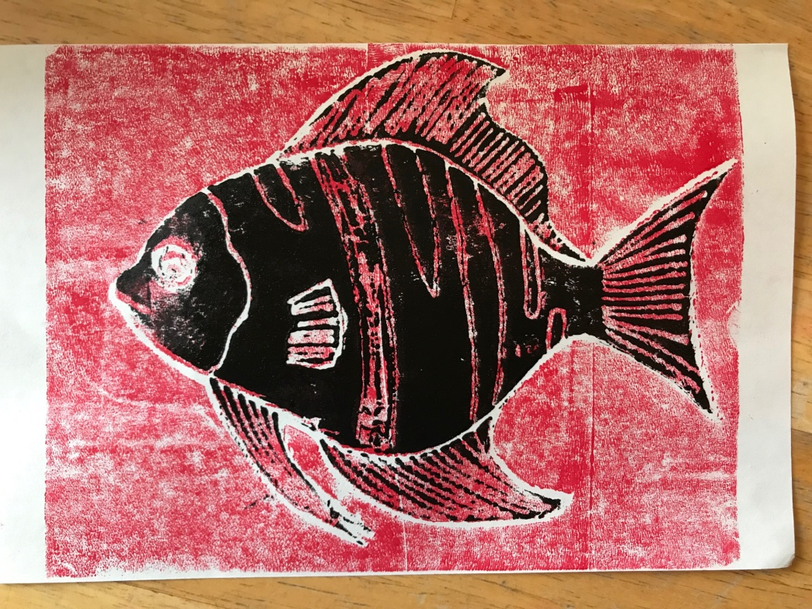
Carefully line up the foam with your original print and place face down. Press firmly and then remove foam from the paper.

