Slide 1
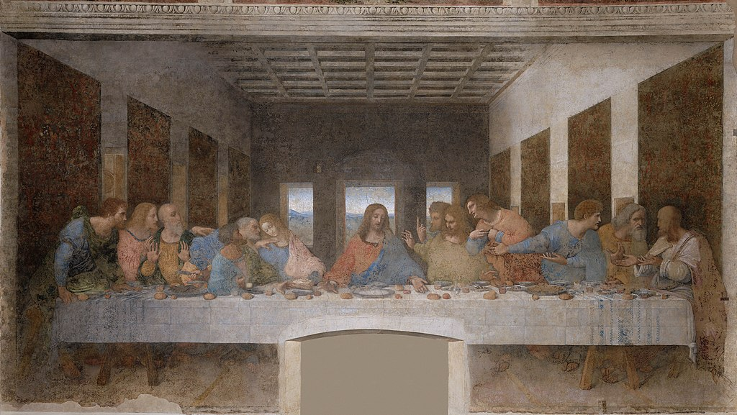
Leonardo Da Vinci
Linear Perspective

Slide 2
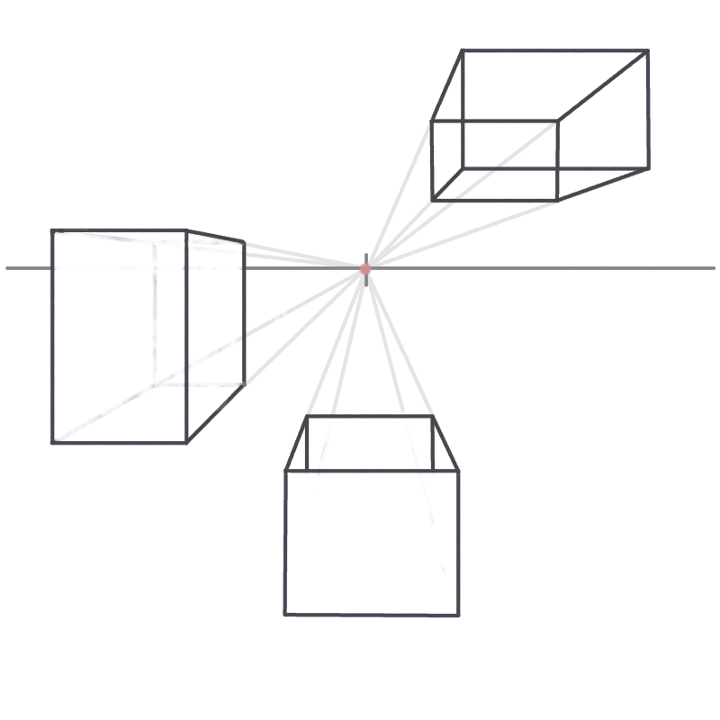
Perspective
Perspective is an Art word for making something look 3-dimensional… also called 3-D

Slide 3
Perspective
The spot where the objects disappear to is called the “Vanishing Point”

Slide 4
Perspective
The spot where the objects disappear to is called the “Vanishing Point”

Slide 5
Perspective
To make objects show perspective, you first draw the objects normal… then you add lines from each corner that disappear when they hit the vanishing point.

Slide 6
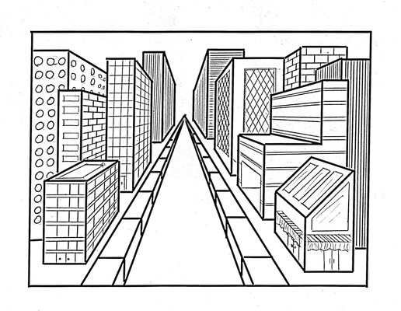
Perspective
Can you find the vanishing point in this drawing?

Slide 7
Perspective
Can you find the vanishing point in this drawing?

Slide 8
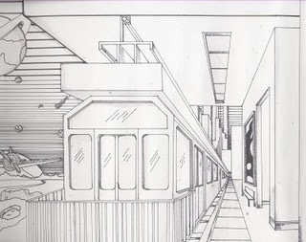
Perspective
Can you find the vanishing point in this drawing?

Slide 9
Perspective
Can you find the vanishing point in this drawing?

Slide 10
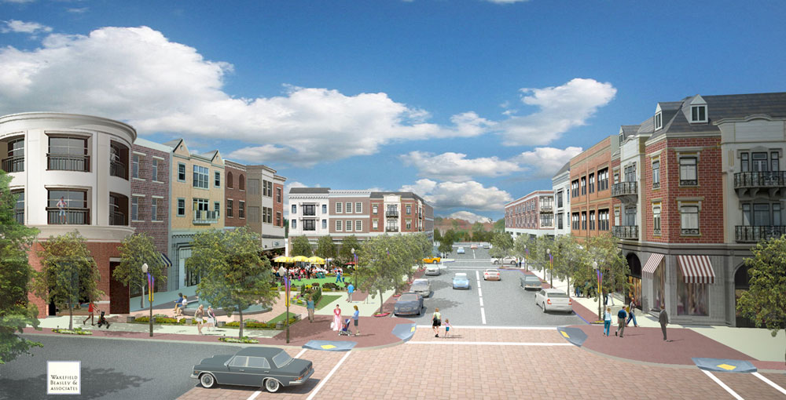
Perspective
Can you find the vanishing point in this picture?

Slide 11
Perspective
Can you find the vanishing point in this picture?

Slide 12
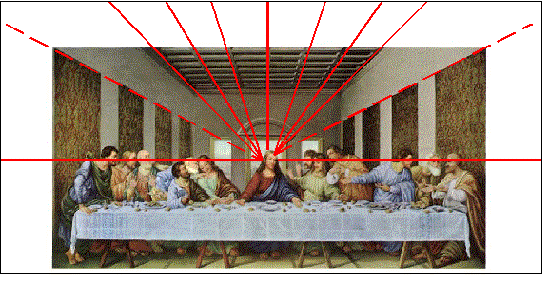
In Da Vinci’s painting The Last Supper, he also used one point perspective as a way to show distance and dimension.

Slide 13
Let’s create our own drawing using one-point perspective.
Using a ruler and a pencil, mark lines every inch along the edges of your paper.

Slide 14
2. Draw a horizon line in the top third of your paper. Use your ruler to mark your vanishing point 6 inches along the line.

Slide 15
3. Draw 3-6 lines from the vanishing point to the marks on the edges of your paper.

Slide 16
4. Add a few trees and buildings in the distance (along your horizon line).

Slide 17
5. Color them in with black sharpie.

Slide 18
6. Using watercolor pencils, draw “tulips” and shade each section lightly.

Slide 19
8. Color in the sky and add water to blend the shaded sections.

