Slide 1
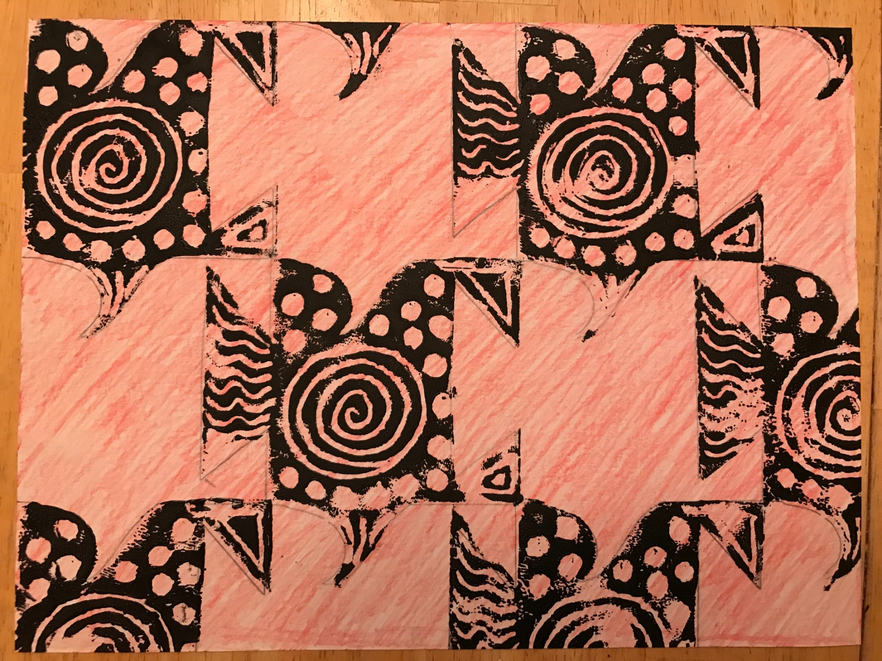
M.C. Escher
Block Print Tesselation

Slide 2
M.C. Escher
Born in Holland in 1898.
Attended a technical college to study architecture but soon discovered his love for drawing and printmaking
Traveled to Italy in 1922, where he met his wife.
Moved back to the Netherlands when Europe was gearing up for World War II.
His works were highly mathematical.
Favorite medium is printmaking.

Slide 3
Tessellation: an arrangement of closely-fitted shapes in a repeated pattern without gaps or overlapping.

Slide 4
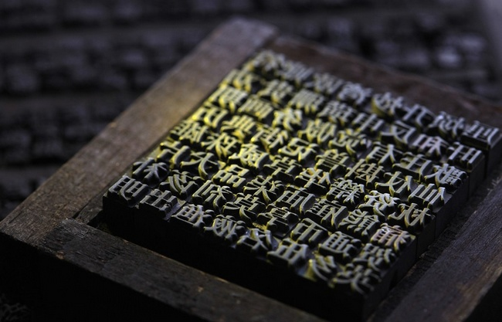
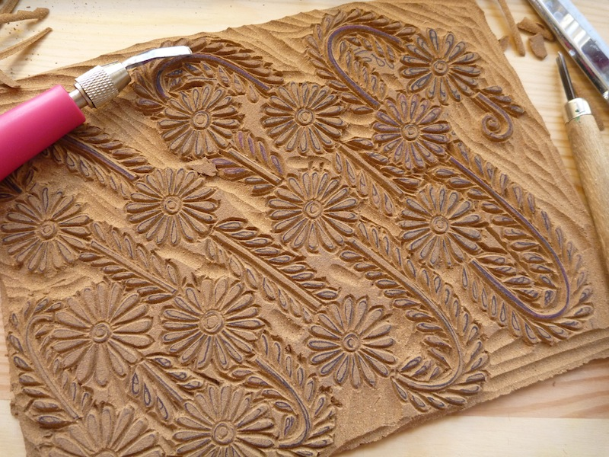
Block Printing
The Chinese used block printing to make books as early as the 9th century. They would carve a page of words into a block and use ink to reproduce it on a page.
Nowadays, block printing is considered an art form. Essentially, it is a stamping technique, where ink is rolled onto a custom-carved block.
Today you will carve into a soft linoleum block to create your own print.

Slide 5
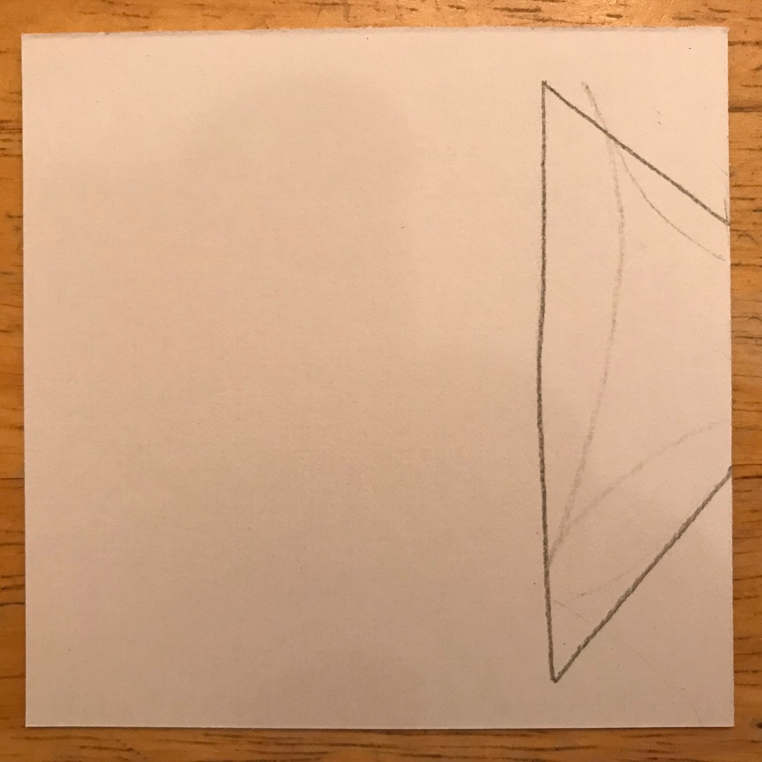
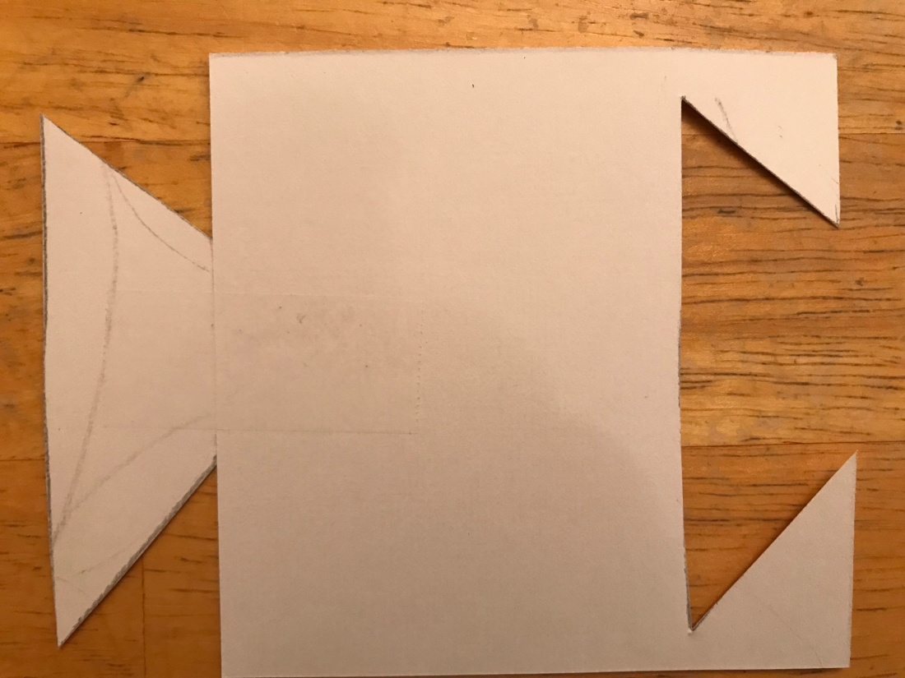
Let’s combine the two and make a block print tessellation.
1. Draw a shape to cut out on one side of your square of cardstock(smooth side up). Cut it out and tape it on the EXACT opposite edge of the cardstock.

Slide 6
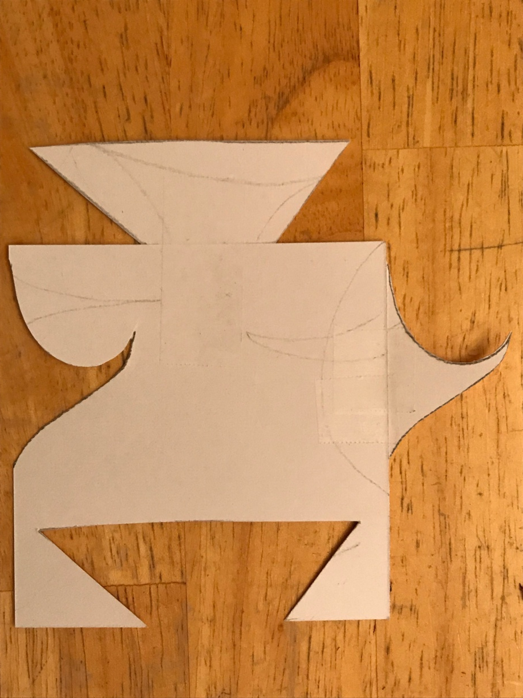
2. Turn your card 90 degrees and repeat step 1.

Slide 7
3. Take your completed tessellation pattern and line it up with one corner of your large piece of paper. Trace around it.

Slide 8
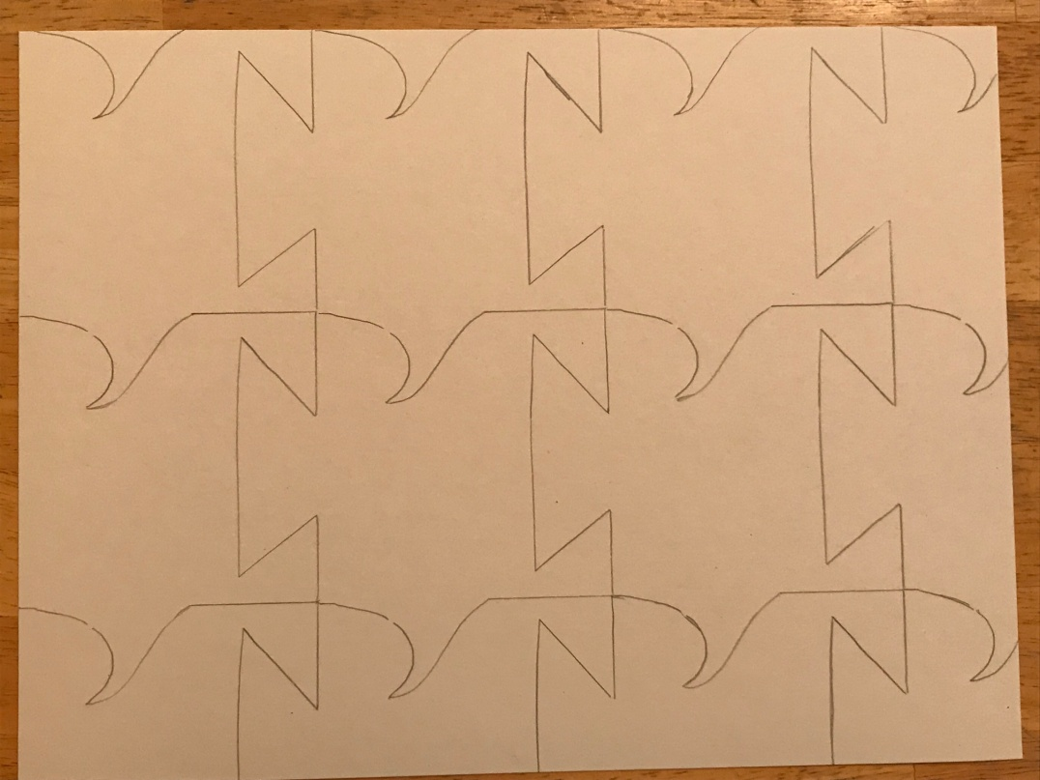
4. Line the pattern up next to it and trace again. Repeat until entire page is filled. Remember that the tessellation pattern will not fit neatly within the paper…it will go off the page in some places.

Slide 9
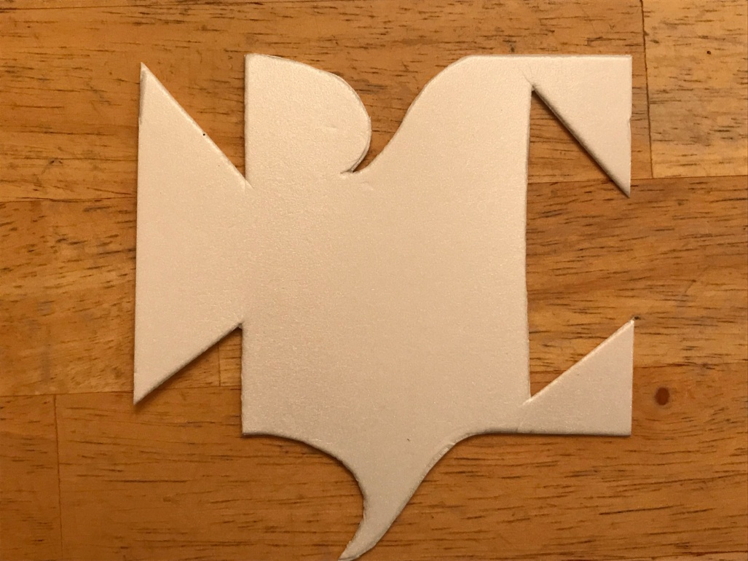
5. Place your tessellation pattern on a piece of scratch foam and trace around it. Then cut the shape out of the foam.

Slide 10
6. Use a wooden stylus to scratch a design into one side of your foam pattern. Important: The side you use must line up on your tessellation face down.

Slide 11
7.Color in the entire sheet of paper with a single color. Make sure your tessellation lines are still visible.

Slide 12
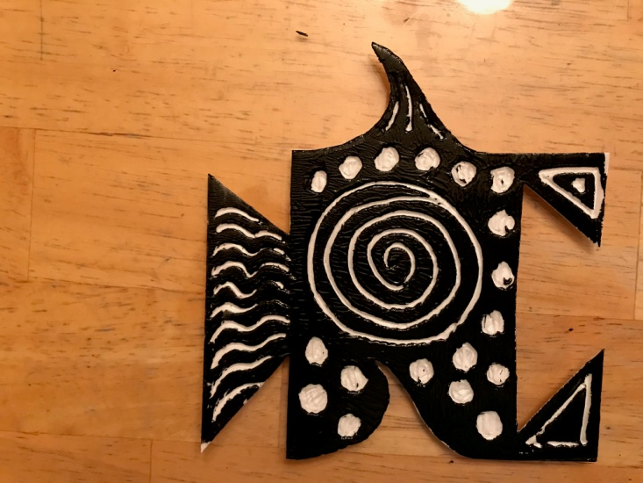
8. Apply dark-colored ink (with a brayer) to the foam and fill in every other section of the tessellation.

