Slide 1
100

Slide 2
200

Slide 3
300

Slide 4
400

Slide 5
500

Slide 6
100

Slide 7
200

Slide 8
300

Slide 9
400

Slide 10
500

Slide 11
100

Slide 12
200

Slide 13
300

Slide 14
400

Slide 15
500

Slide 16
100

Slide 17
200

Slide 18
300

Slide 19
400

Slide 20
500

Slide 21
100

Slide 22
200

Slide 23
300

Slide 24
400

Slide 25
500

Slide 26
Learning Resources

Slide 27
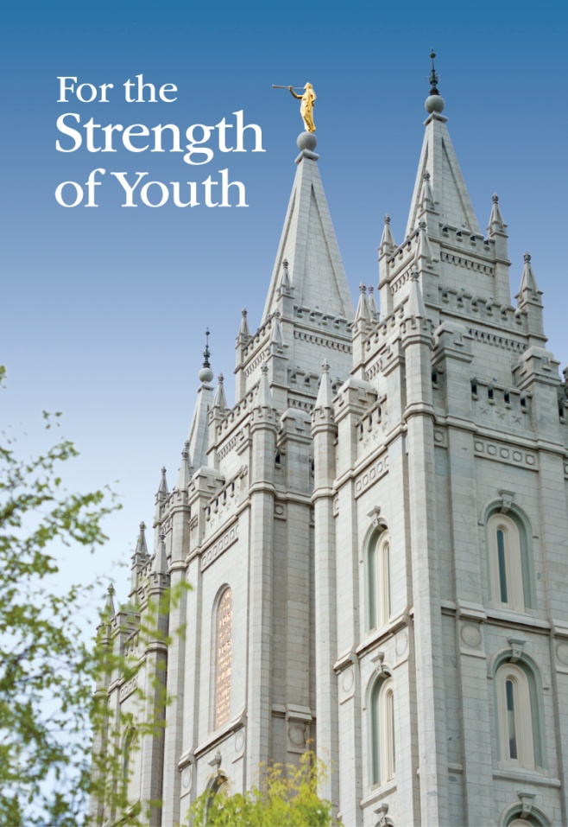
What is For the Strength of Youth?

Slide 28
The booklet in which the First Presidency outlines gospel standards and teaches youth how to apply them.

Slide 29
What are the Standard Works? (Or, what are the scriptures?)

Slide 30
The Bible, Book of Mormon, Doctrine and Covenants and Pearl of Great Price.

Slide 31
What is Come Follow Me (for Aaronic Priesthood Quorums and Young Women Classes)?

Slide 32
The curriculum for youth that is taught in Sunday classes twice a month.

Slide 33
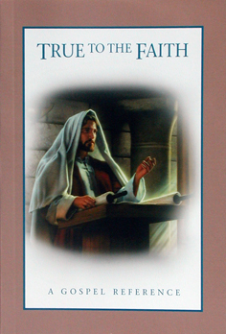
What is True to the Faith?

Slide 34
This book is designed as a companion to studying the scriptures and the teachings of latter-day prophets. It contains brief, simple statements on gospel doctrines and principles, arranged alphabetically.

Slide 35
What is For the Strength of Youth?

Slide 36
The church magazine designed for youth. (Hint: it underwent a name change this year)

Slide 37
Service and Activities

Slide 38
What is preparing, blessing or passing the sacrament, ministering to members of our ward, serving in class and quorum presidencies and participating in temple and family history?

Slide 39
Some ways in which youth get to serve in the kingdom of God.

Slide 40
What is Wednesday?

Slide 41
The day of the week on which Youth activities are held in our ward.

Slide 42
What is JustServe.org?

Slide 43
The website we often use to find local service activities.

Slide 44
What is Young Women Camp?

Slide 45
An overnight activity usually held once a year where Young Women can gather together, separate from worldly influences, feel the Spirit of the Lord, grow in unity and love, and strengthen their faith and testimonies of Heavenly Father and Jesus Christ.

Slide 46
What is an FSY (For the Strength of Youth) conference?

Slide 47
A gathering for local youth that features five days of devotional, classes and activities designed to help you strengthen your faith in Jesus Christ and feel joy and belonging as you live the gospel.

Slide 48
Themes and Emblems

Slide 49
What is the temple?

Slide 50
The symbol found on the pendant Young Women receive and the ring the Young Men receive when they enter the program.

Slide 51
Who is Jesus Christ?

Slide 52
The person depicted in the Children and Youth crystal.

Slide 53
What is the Aaronic Priesthood Quorum Theme?

Slide 54
This statement, revised in 2019, helps members of Aaronic Priesthood quorums better understand their identity and responsibilities.

Slide 55
What is the 2021 Youth Theme?

Slide 56
Doctrine and Covenants 64:33-34 “Wherefore, be not weary in well-doing, for ye are laying the foundation of a great work. And out of small things proceedeth that which is great. Behold, the Lord requireth the heart and a willing mind.”

Slide 57
What is the Young Women Theme?

Slide 58
A statement of faith that young women repeat often as a of their divine identity and purpose.

Slide 59
Personal Development

Slide 60
What is the Children and Youth Program?

Slide 61
This program was implemented by the church in the fall of 2019. Its purposes are based on the scripture in Luke 2:52 “And Jesus increased in wisdom and stature, and in favour with God and man.”

Slide 62
What are Spiritual, Intellectual, Physical, and Social?

Slide 63
These are the four areas for setting goals in the Youth Personal Development Guidebook.

Slide 64
What is Luke 2:52?

Slide 65
This scripture that forms the basis for the Children and Youth program is found at this reference.

Slide 66
What is twelve?

Slide 67
You become eligible to enter the Young Women or Young Men program the year you turn this age.

Slide 68
What is the temple?

Slide 69
The picture on the Young Woman Medallion you receive after completion of the Personal Progress program.

Slide 70
Miscellaneous

Slide 71
What is the bishop?

Slide 72
The president of the priest’s quorum is also known as this.

Slide 73
What is a limited-use temple recommend?

Slide 74
A document signifying that you consider yourself worthy to enter the House of the Lord. Is issued by a member of the bishopric following an interview and is good for one year.

Slide 75
Who are the General Young Women Presidency of the church?

Slide 76
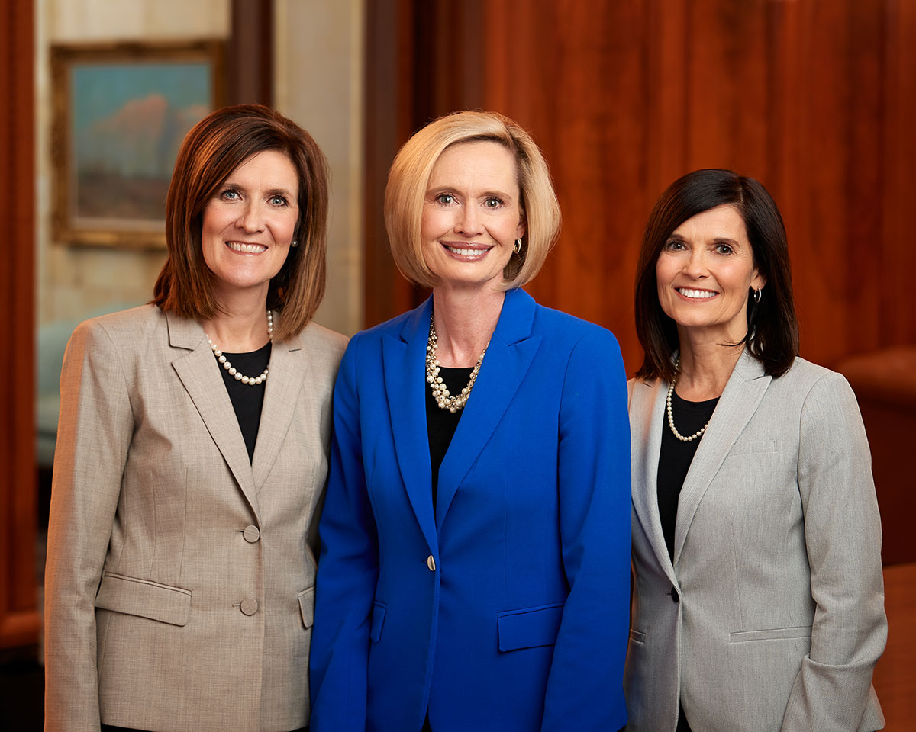
Sister Craig, Sister Cordon, and Sister Craven

Slide 77
What is the Gospel Living app?

Slide 78
A mobile app designed to support a Christ-centered life through inspiring content, reminders, activity ideas, communication, journaling and personal goals.

Slide 79
What is Youth Conference?

Slide 80
An activity or series of activities for youth held once a year on a ward or stake level that helps youth build faith in Jesus Christ, strengthen their testimonies, develop talents, make new friends and have fun with youth who share similar beliefs and standards.

